Slide 1
Instructor Notes
Ensure you update your contact information on the Title slide
This class is a combination of Lecture, Demo and Lab
Class duration is expected to be approximately 6 hours
All Demos and Labs are described in the slide Notes
File Student Modeling_PreClass.pbix does not have all DAX applied, and will be used by the students in Labs.
Save a copy of this file to add DAX and perform demos during class. It is easier to save a copy as in one demo, you will need to show “before and after” file sizes
File Instructor Complete Modeling.PBIX has all complete DAX and relationships applied. Use this file for Demos.
Answers to the Knowledge Checks can be found in the Appendix
Both PBIX files have a FullPath parameter which can be adjusted to the location of the source data file VanArsdel_Actuals.xlsx
The 3 appendixes at the end of the presentation are optional and can be included after the relevant modules
Download and install Power BI Desktop:
Download and install Microsoft Power BI Desktop from: http://www.microsoft.com/en-us/download/details.aspx?id=45331
Version: Feb 2020
Notes:
Change Log
Insert slide between 21 and 22 showing the three modes
Import Mode
Live Connect
Direct Query
After Import Mode (slide 27)
Insert 1 -2 slides on Live Connect
Insert 1-2 slides on Direct Query
Use slide 103 iterator function Example 3 as a way to introduce variables
Clean up Values, vs Distinct, vs All
Cover when demoing and remove everywhere else
Maybe add variables as a concept or not.
Typo(slide 24; slide 52): slower -> is slow; Sumarizations -> Summarizations
Reorganize the layout of slide 29, 30, 34, 35, 44, 63
Add notes on Slide 70, 71, 72, 74
Add comment on Slide 72
Add missing subtitle “Filter context in a measure – Example 1” on Slide 82

Slide 2
Data Modeling and Data Shaping
Presenter Name
Version: February 2020
Notes:
Purpose of this presentation: Power BI Modelling
Target audience: Analysts, Report Builders

Slide 3
Prerequisites and Setup Steps
Internet connectivity: You must be connected to the internet
At minimum, a computer with 2-cores and 4GB RAM running Windows 8 / Windows Server 2008 R2 or later
Microsoft Power BI Desktop requires Internet Explorer 10 or greater
Verify if you have 32bit or 64bit operating system to decide if you need to install the 32bit or 64bit applications.
Search for computer on your PC, right click properties for your computer
You will be able to identify if your operating system is 64 or 32 bit based on “system type” as shown below
Download and install Power BI Desktop: Download and install Microsoft Power BI Desktop from http://www.microsoft.com/en-us/download/details.aspx?id=45331. Optionally, you can also install the Power BI Desktop tool from the Power BI Desktop Install folder on the flash drive that will be provided on the day of the session. Please choose appropriate 64-bit or 32-bit version depending on your platform. Microsoft Power BI Desktop is available for 32-bit (x86) and 64-bit (x64) platforms
Download Class Files:
Copy Files from your USB to C:\Power BI_Adv_M\ (Please return the USBs) or download from:
https://partner.microsoft.com/en-US/asset/collection/advanced-shaping-student-collection#/
DIAD: This class assuming that the attendees have already taken Dashboard in a Day and have previous 100 level knowledge of Power BI
NOTE: This lab is using real anonymized data and is provided by ObviEnce LLC. Visit their site to learn about their services: www.obvience.com.
This data is property of ObviEnce LLC and has been shared for the purpose of demonstrating PowerBI functionality with industry sample data. Any uses of this data must include this attribution to ObviEnce LLC.
Notes:
Update Title Slide:
Instructor Name, Title & Company
Instruct the students to copy the files (note, as the Module 4 Lab: Creating Parameters and Paths has them creating a dynamic path, they actually can put the files wherever they want to).

Slide 4
COURSE OBJECTIVES
By the end of this course, you will be able to use M to create DAX to create calculations in a Power BI Desktop data model. Specifically you will be able to:
Understand the Power BI Desktop data model, its components and most effective schemas
Be able to create queries in M and DAX
Understand parameters
Import data from a variety of sources (including XLS and CSV files)
Understand concepts of calculated columns and measures
Understand the use of functions
Gain familiarity with standard DAX patterns & CALCULATE
Gain ability to parse data modeling formulas
Understand the consequences of data model design decisions

Slide 5
COURSE AGENDA
 |  | Introductions and Overview
Module 1 |  | Data Modeling Basics – Getting the Data
Module 2 |  | Getting started with M (Power Query Language) & Relationship between tables
Module 3 |  | Fact Table, introduction to DAX Calculated Columns & Measures
Module 4 |  | Working With Parameters and introduction to DAX
Module 5 |  | Working with functions - DAX CALCULATE Function, custom functions & Time Intelligence Functions
Module 6 |  | Modeling with Power BI & DAX best practice Data Modeling, Optimization techniques
Module 7 |  | Summary
 |  | Wrap-up & Questions

Slide 6
Introduction

Slide 7

Event Evaluation
Your feedback is important to us!
From your PC, Tablet or Phone, visit
http://aka.ms/AnalyticsAirliftSurvey
https://aka.ms/AnalyticsAirliftPBI
to fill out event evaluation.
Notes:
http://www.surveygizmo.com/s3/3625920/DIS-Partner-Pre-Day

Slide 8
Get Involved on Social
Join the Power BI Community
Event Hashtag: AnalyticsAirlift
https://community.powerbi.com/
Follow us on:
Twitter: @MSPowerBI
Facebook: Microsoft Power BI

Slide 9

Power Platform Community

Slide 10

What we are Trying to Help with

Slide 11
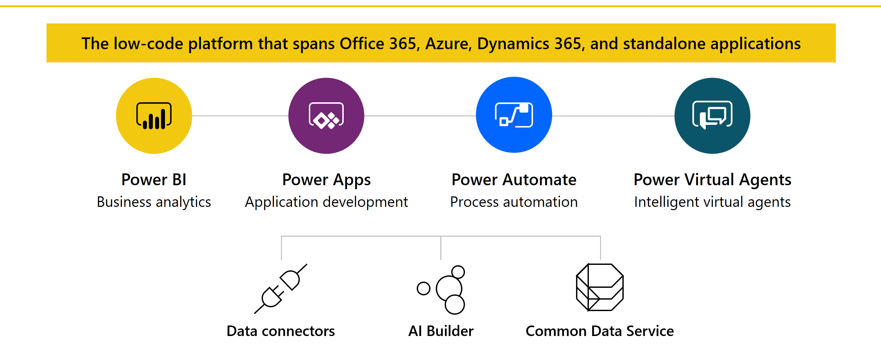
Microsoft Power Platform

Slide 12
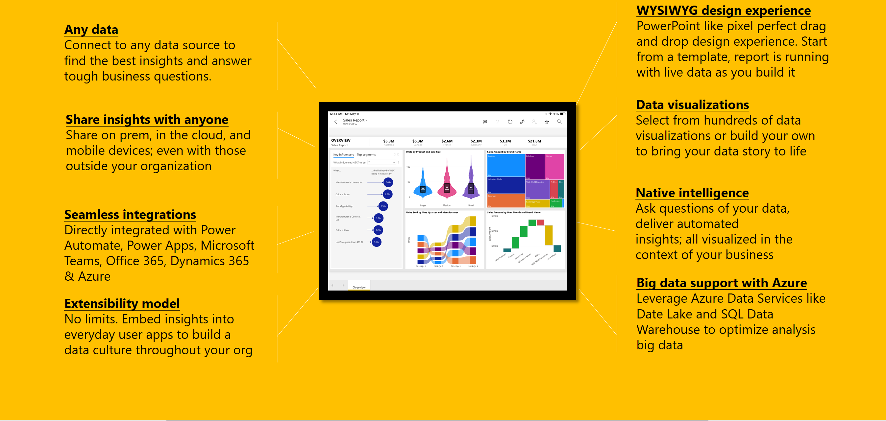
Anatomy of a Dashboard

Slide 13
Module 1 –
Getting the Data & Basic Data Modeiling in Power BI Desktop

Slide 14
MODULE 1 OBJECTIVES
Understand what is meant by data model in the context of Power BI
Understand the consequences of data model design decisions
Understand consequences of Power BI’s data type handling

Slide 15
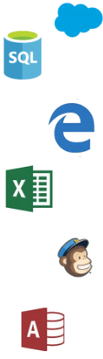

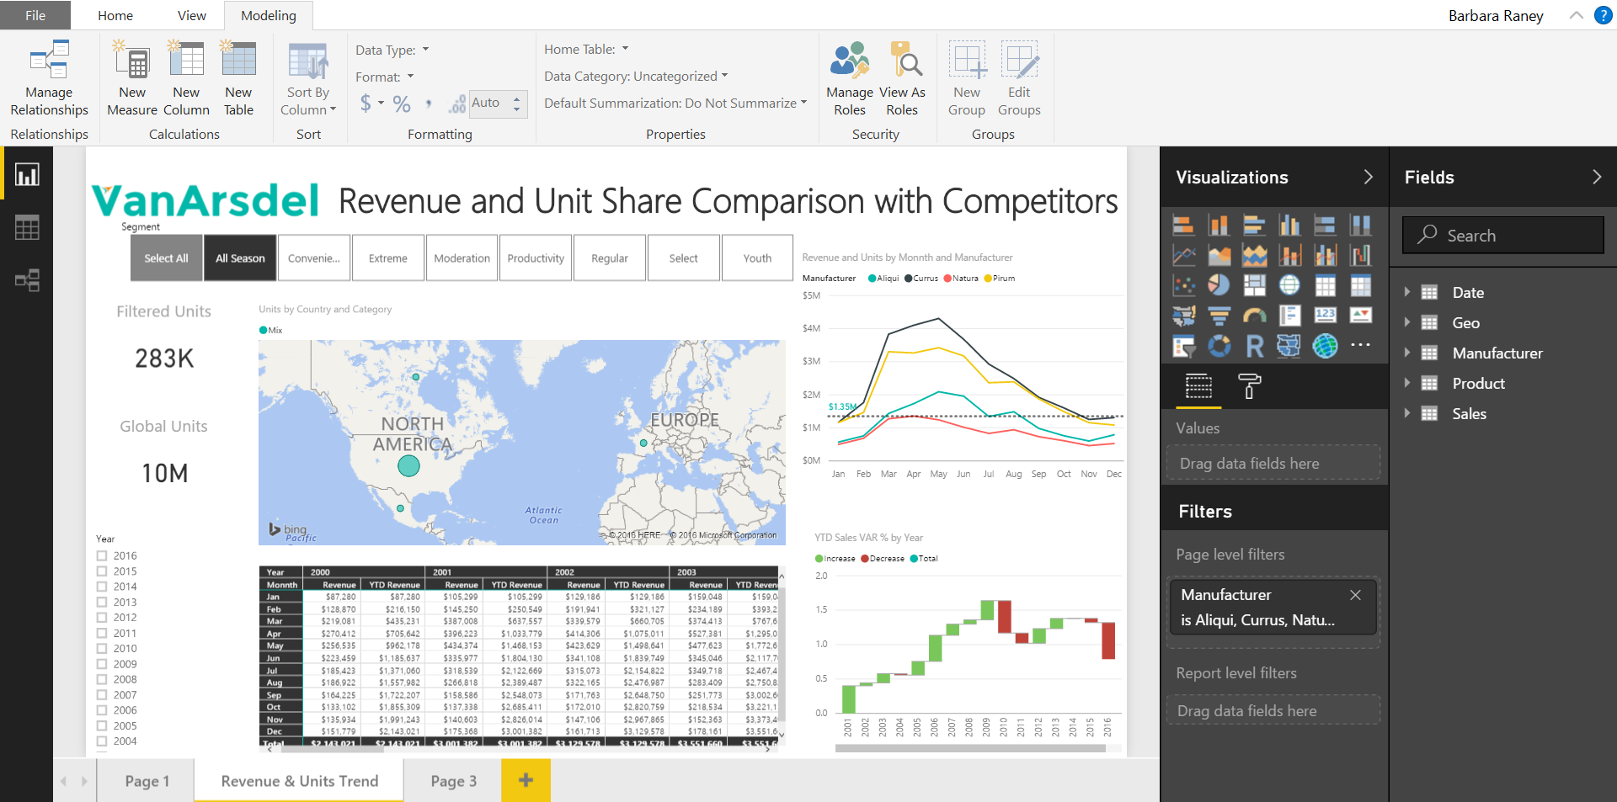
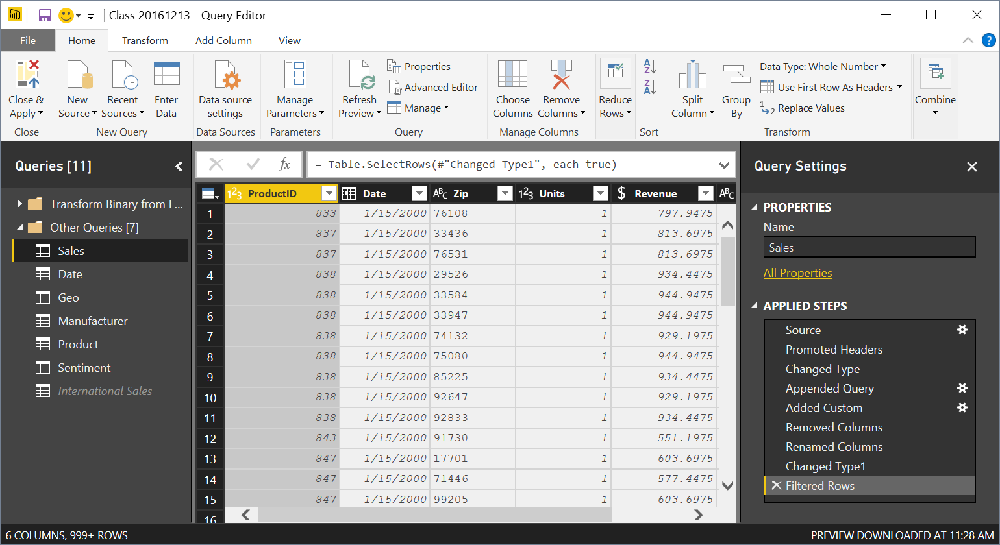

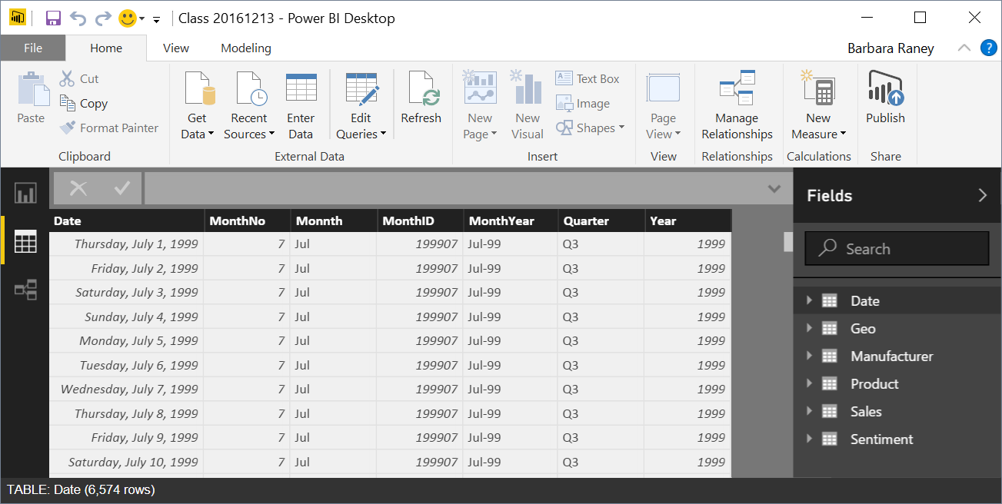
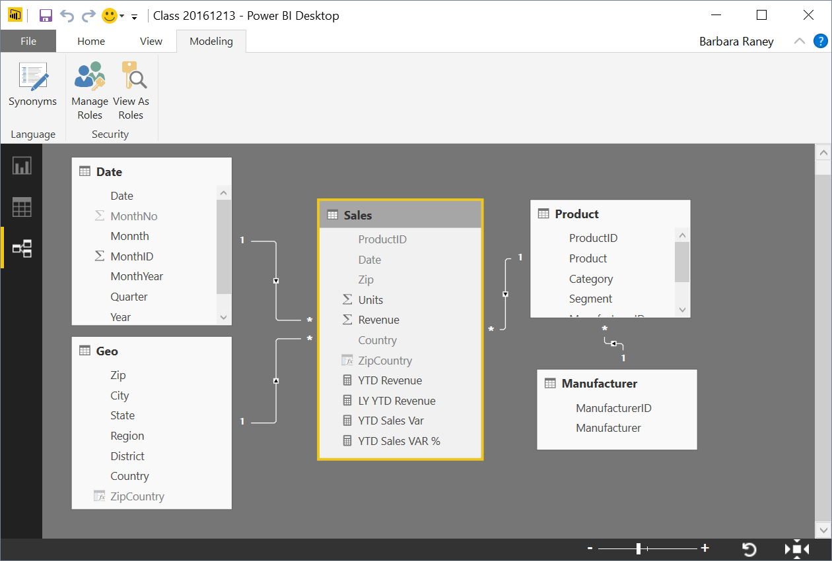


Power BI Desktop Data Flow
Data Sources
Power BI Desktop file (.PBIX)
Report
Create Visuals
Close & Apply
Close: Closes Query Editor
Apply: Loads data from sources to Data Model
Data (DAX)
View Tables
Query Editor (M)
Data Source Connections
Data Transformations
(Prep data for Data Model)
Relationships
See how Tables relate to each other
Notes:
This build slide emphasizes that the Query editor is for transformations and is a different window than the primary modeling views.

Slide 16
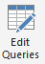

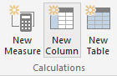
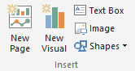
Phases in Building a Power BI Desktop File
Power BI Desktop Files
“Get Data” Phase
Model Creation Phase
Model
Enhancement
Phase
Visual
Building Phase
Create Query in “M”
Compress data, auto detect relationships
(Automatically done by Tool)
Add calculated columns, measures, add missing relationships
Evaluate Measures and build each visual
Notes:
In Power BI desktop connect to Raw Data Excel file that contains all data for the Power BI model. Pull Sales Fact , Geo and Date
Show the Get data phase
Show how if you do apply later and save just the “Query information” is saved
If you apply data – Data transformation changes are saved (All data is loaded, and most relationships are created)
Add a relationship for the date column
Show how you can add a calculated column and measure
Calc Column on Product Dimension: Price Band = IF(ProductDim[UnitPrice]> 10, “High”, “Low”) – memory inefficient – less optionally compressed as is not sorted
Measures: Total Sales = Sum(SalesFact[Sales]) – no result yet – as a measure is ONLY calculated when a visual is built
Finally build a few visuals and show how the measures are evaluated during visual building phase – you can start with a simple matrix to check values
Process Time Vs. Query Time
Time to take to process the model (Process) includes all calc columns
Time to build a Visual (Query) includes measures

Slide 17
What is a Data model?
A Power BI Data Model is a collection of tables with relationships which enable your business users to easily understand and explore their data to get business insights.
Why is it important to have a Good Data model?
Improves understandability of the data
Increases performance of dependent processes and systems
Increases resilience to change
Notes:
In a good Data Model, the model can assume that column types are homogeneous (as they are strongly typed). This is different from Excel, where any given cell in a spreadsheet can contain different data types.

Slide 18
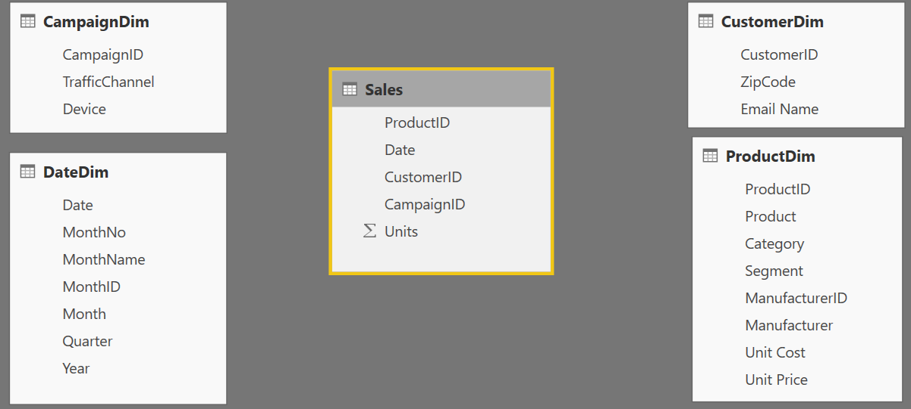
Components of a data model – Fact Table
Fact
Table
Fact Table
Contains Measures (or items to be aggregated) of a business process Examples:
Transactions
Sales Revenue
Units
Cost
Measures are usually sliceable.
Examples: By Month,
By Customer
Notes:
This slide builds automatically.
Depicts the data flow for Power BI Desktop along with what is in a PBIX file.
Note all the data sources that can be pulled into Query Editor.
Not the different views (Report, Data, Relationships) once all of the data is pulled in.
Ask about Fact tables
Mention Kimball
Measures to improve the scale overall

Slide 19
Components of a data model – Dim Table
Dim
Table
Dim
Tables
Dim
Table
Dim
Tables
Dim Table
A Dim (or Dimension) table contains descriptive attributes that define how a fact should roll up.
Examples:
By month, By Customer, By Geo
Notes:
The BY’s will be the dimensional attributes that we will use to describe the facts.

Slide 20

Components of a data model - Relationships
Relationships
Connection between a 2 tables (usually fact & Dim tables) using columns from each
3 kinds of Relationships
1 to Many
1 to 1
Many to Many
(with a bridge table)
Relationships
Relationships
Notes:
A Relationship is analogous to how an Excel VLOOKUP function brings two tables together
Can observe which side is the many (*) and which is the one (1) - CARDINALITY
When you draw the relationship, Desktop does several heuristic things
It checks that one side of the relationship is the “One” and the other is the “Many”
Directions of Relationship
Uni-directional are created by default and allows filters to get passed from attribute (dim) table to the Fact
Bi-Directional relationship allow you to pass filters in both directions
This is different than Many to Many
There is a significant performance penalty for Bi-Directional filtering

Slide 21
Data Model Brings Facts and Dimensions Together
Type of Data Models
Star Schema
Snowflake Schema
Flat or Denormalized
Note: This is not an exhaustive list, but are the most common model types used by Power BI.
Notes:
Flat or denormalized schema for the data model
Ask if anyone knows audience engagement

Slide 22
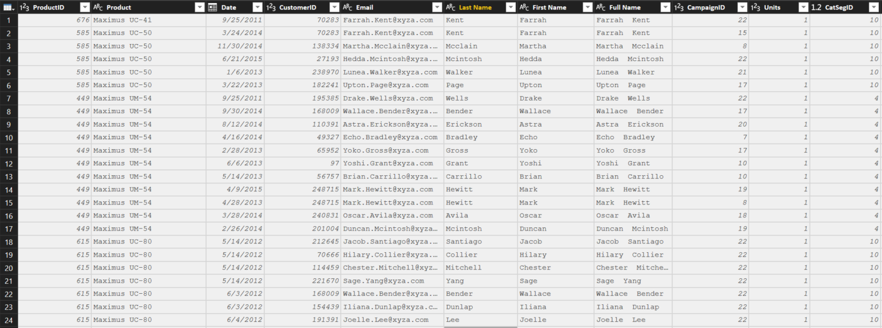
Flat or Denormalized Schema
All attributes for model exist in a single table
Highly inefficient
Model has extra copies of data > slow performance
Size of a flat table can grow and quickly “blow up” as data model becomes complex
Notes:
Like Excel with many V-Lookups
Denormalized are flattened versions where all attributes are copied into the same table
This is a requirement of a certain “T” competitor – and a major differentiator in the market
If denormalize everything than it is a problem computing time will be very long
Update the slides – for the specific product, review the slide

Slide 23
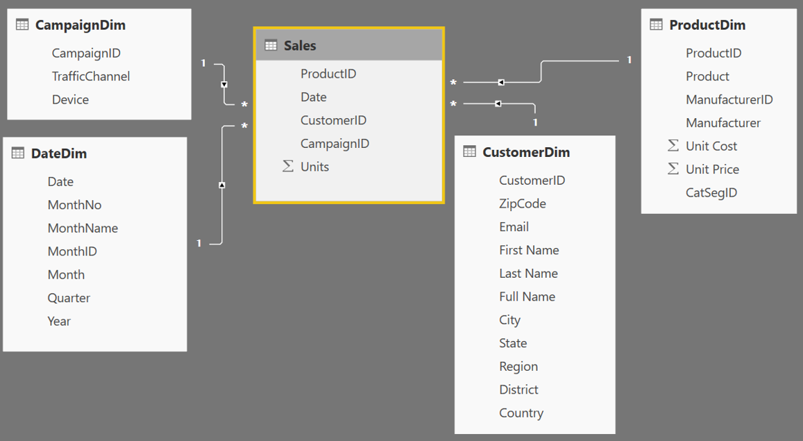
Star Schema
Fact table in the middle
Surrounded by Dims
Looks like a ‘Star’
Fact table is the “Many” side of the (one to many) relationship
1
1
1
Many
1
1
Many
Notes:
By extracting the repeated attributes to dimension tables, you are lowering the amount of memory required by the data model.

Slide 24
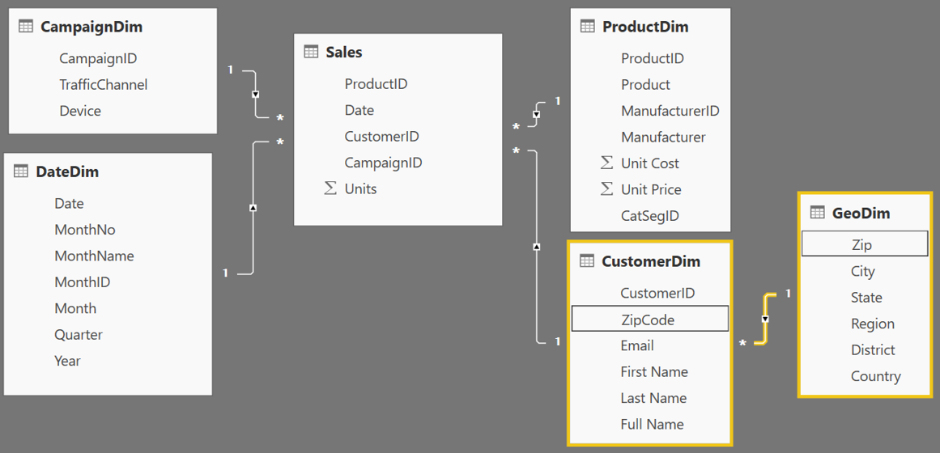
Snowflake Schema
Center is a Star schema
Fact table in middle
Surrounded by Dims
Dims “snowflake” off of other Dims
If you have many, it looks like a ‘Snowflake’
Dim or Fact tables can be the “Many” side of the relationship
Dims
Facts
Dims
Flake
Snowflake
Notes:
“Snowflaking” off tables can be very beneficial when your dimensions have several repeating attributes that can be extracted to their own table.
A zip code is associated with multiple attributes
Talk about your own zip code and the richness associated with that particular zip

Slide 25
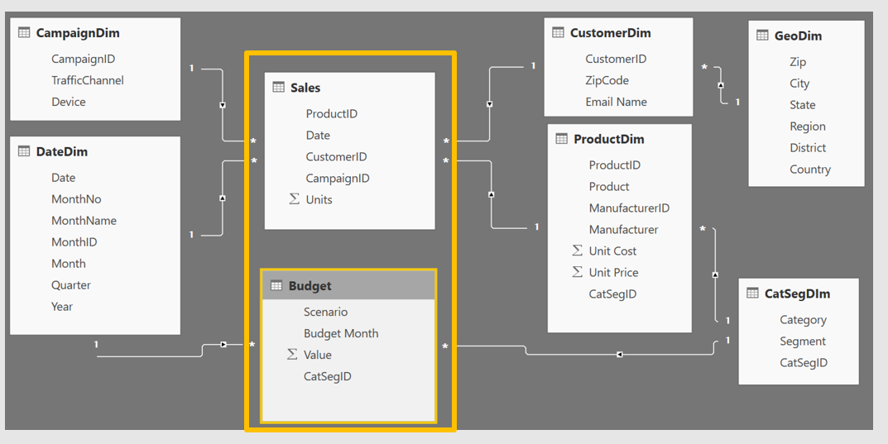
Granularity & Multiple Fact Tables
Grain (granularity) measures the level of detail in a table
Example:
One row per order or per Item
Daily or Monthly date grain
If your facts have very different granularities, split them into Multiple Fact tables & connect them to shared dimensions at the lowest common granularity.
Sales (Daily by Product)
Budget (Monthly by Product Category & Product Segment)
Notes:
Keep in mind, your measures (calculations) should be placed on a fact table, but it really does not matter which one. The key is that measures should not be placed on dimension tables.
When you have a fact at the Month grain, like budget, you can create a calculated column which holds the first (or last) day of the month to use in creating the relationship.
Emphasize that if the month id is unique a join can happen

Slide 26



How can I tell what Data Model Type I have?
Data Mode Types in Power BI
Live Connect to SQL Analysis Services (SSAS) tabular
Report view only available
DirectQuery to SQL or other relational source
Report & Relationship views available
Import data into Power BI (creates a copy of the data)
Report, Data and Relationship views available
Notes:
Quick note with 2 pictures Black Nav bar that shows a live connect doesn’t have the relationship or the data tab
Direct Query doesn’t have the Relationship option
Power BI currently supports both of the models

Slide 27
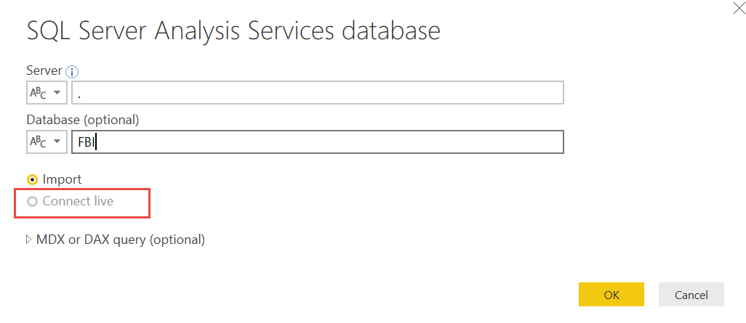
Connection: Live Connect
Live Connect to Multidimensional or Tabular
On Premise or Azure
Only a single connection will be made and all modeling is done in the cube
You can not add relationships or additional data source
If allowed, you can add DAX measures

Slide 28
Choosing storage mode: LiveConnect
Mode used when Power BI model accessing an SQL Server Analysis Services (SSAS) data model
Can be a server (IaaS) or Azure Analysis Services (PaaS)
When is it appropriate
Organization has already invested significantly in SSAS, have mature models
High level of control needed around partitions, data refresh, query scale-out and workload splitting
Granular auditing, monitoring and diagnostics
Integration with CI/CD or similar automation pipelines
Models can’t fit in Premium (P3+ models up to 10GB v. no overall model size limit in SSAS)
Considerations
Strategically we will be bringing AS features to Premium over time
We can enable certain features per customer (e.g. Aggregations in ASAzure)

Slide 29
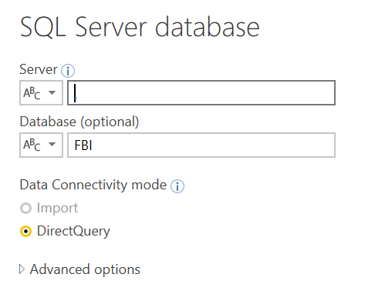
Connection: Direct Query to Relational Source
Direct Query to SQL or other relational source
On Premise or Azure
Composite modeling is possible where some data sources are in Direct Query mode and a few are in Import mode
You can add relationships and DAX
Notes:
Combining Direct Query and import in a single Power BI dataset is supported (composite modeling).
A few things to consider:
Removing fields—best practice is that if it isn’t a field you’re reporting on, think very carefully about whether it needs to be included in the model
Reducing the number of text fields with many unique values—see this whitepaper (https://msdn.microsoft.com/en-us/library/dn393915.aspx) for more information on how tabular models compress data and what you can do to identify the worst offending fields and optimize compression or performance
Reducing the date range of data being brought in—it is common to see business users want to bring in all historical data—it’s worth asking whether their business has fundamentally changed in the last X years where trends from before X years are not relevant

Slide 30
What is unique about Power BI Desktop in Import Mode?
Import Mode
Columnar database
In-memory database
Let us understand some of the internals of Power BI Desktop !!

Slide 31
Choosing storage mode: Import vs Direct Query
Import is your first choice (all in memory = best speed, no DAX limits)
When is it inappropriate
Extremely large data volumes
Need near real-time access to data from source
Considerable existing investment in external DW or OLAP (modelled, conformed, cleaned, calcs defined etc). SSAS MD, SAP HANA and BW are common.
Regulatory and data sovereignty requirements
Considerations
How much source data, how compressible? Rule of thumb is 5x-10x
Is Premium an option? (larger datasets supported there)
Will blended architecture suffice? (Composite models, Aggregations for summary data)
Some limits on DAX in DirectQuery mode (e.g. time intelligence)
Notes:
It’s worth mentioning that the product team recommends DQ mode only in situations where low latency is the driving factor. If you have a situation where import is resulting in too large of a dataset, you should consider optimizing the data you are pulling into better take advantage of the tabular model’s in-memory columnar datastore that’s running in Power BI’s back end.
*************************************
Mention the live connect
Max capacity of usingPower BI– 12G
Premium to each core – slide updated by Siva
Reason to use analysis services – large amount of data
Data refresh frequency

Slide 32
Columnar Database
Row Based Database
PBI - Columnar Database
First Name | Last Name | Sales
John | Smith | $10
Jane | Doe | $25
Hardy | B | $35
First Name | Last Name | Sales
John | Smith | $10
Jane | Doe | $25
Hardy | B | $35
Stores each row separately (like a separate file)
Retrieving multiple columns from a single row is fast
Retrieving multiple rows from a single column is slower
Stores each column separately (like a separate file)
Retrieving multiple columns from a single row is slow
Retrieving multiple rows from a single column is faster
Columnar databases are well suited for analytics
Notes:
No Additional Notes.
Separate file for the row oriented

Slide 33
In-Memory Database
Power BI compresses data to conserve space in RAM
Will help you understand the data modeling for performance optimization
Data stored in RAM (in memory)
RAM is all electronic – Read/Write is fast
(Detailed information in Appendix 2 slides)
Notes:
Every Row is stored in a separate “File”
How many files do I open to get the “total Sales”?
For ANALYTICAL - To get the total sales – it will only need to open ONE File
* Column based architecture is better for Analysis

Slide 34
Data Types
Numeric Data Types
Whole Number
Decimal Number
Fixed Decimal Number (Floating point stored as integer)
Boolean
Date/Time Data Types
Date – Internally stored as an integer
Time – Internally stored as a fraction between 0 and 1
Date Time
Other Data Types
Text
Any – You should never see this in a data model. Bad things can happen!!
Set your Data Types in the Query Editor
Set your Data Formats ($ %, etc) in the Data Model
Pro Tip: Data type is different from data format
Notes:
Data Types are how data is stored, as opposed to Data Formats which are how data are displayed
Discuss the difference between Fixed Decimal (Currency) and Decimal (which has floating decimal)
Fixed Decimal is 19.4 – 19 places to left of decimal and 4 to the right, which allows for proper processing of pennies. Best for Currency numbers.
Decimal can be less efficient when the data has excessive precision
Discuss splitting DateTime into Date and Time columns so that they compress better
Fixed Decimal numbers – stored like whole number uses less memory than Decimal

Slide 35
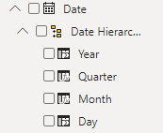
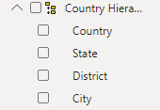
Hierarchies
Power BI generates Date hierarchies when dates are added to visuals, this allows the end user to drill from Year, Quarter, Month & Day.
Users can also create custom hierarchies in the model by dragging a lower level field onto the parent.
Notes:
Can approximate hierarchies in the drill path of a visual

Slide 36
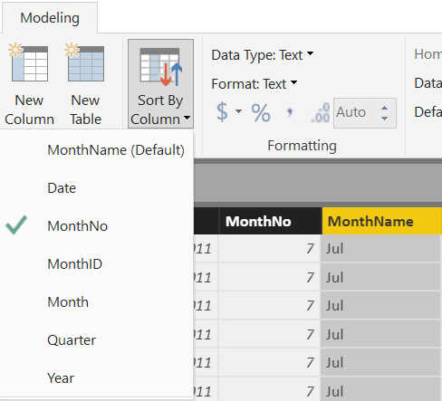
Sort By Column
Enables sorting one text field by another (numeric) field
Both columns must have the same number of distinct values
Notes:
Sort by Column was shown in DIAD, but it is important modeling concept to know.
This is applied in the Data section of the model.

Slide 37
Module 1 Lab
Open a new Power BI File
Make sure your have got 2 Excel files as your data sources on your computer
Follow the instructions of Lab 1 in your student handout
Notes:
The final relationship diagram can be viewed in the Instructor Complete Modeling.pbix file.

Slide 38
MODULE 2: Getting Started with M – Power Query Language

Slide 39
MODULE OBJECTIVES
Objectives
Understand the basics syntax of the M Language
Understand function & keyword structure
Understand how to connect to data
Understand the basic structure of the Advanced Editor
Agenda
Power BI M Language Overview
Basic Data Import
Introduction to Text functions
Create and Apply Degenerate Dimensions
Notes:
In the first module, we explored the data components of the Power BI architecture and best practices in data modeling. Along the way, we learned some Power BI terminology and how to organize our data within the tool. Now, we will explore the Power BI power query language, M, to deepen our knowledge and walk through how to import data from a variety of sources

Slide 40








M has amazing capabilities to transform data to optimize it for the data model
Why M?
Notes:
Take data from disparate sources and transform it into the correct “Shape” for the data model.

Slide 41
How do I use M?
Three ways to write M
Click and Adjust
Custom Code
Use the Ribbon
Simple
Advanced
Notes:
There is nothing wrong with using the UI to create your queries, but the language is SO much more powerful than just what is in the UI. By learning how to read the code generated from the UI and then updating it to suit your needs, you can accomplish incredible transformations.

Slide 42
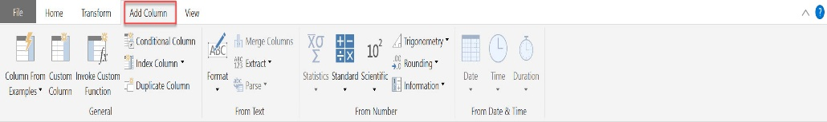
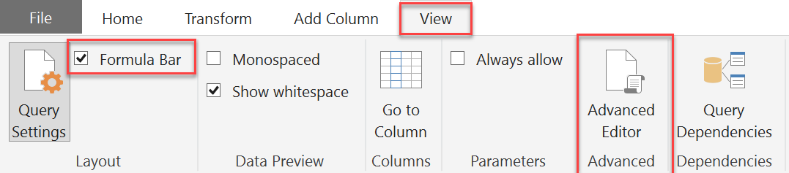
Key Concepts of M syntax
M is the key to data transformation in Power BI
Many transforms are just a click away on the Ribbons
Turn on Formula Bar to see M syntax generated by clicks
View full syntax in Advanced Editor
M is Column Based
Many Transformations occur by adding columns
M is CaSe SeNsItIvE!
Notes:
Walk thru each of the four ribbons. Note that this is in Power Query and we haven’t connected to any data so if they just open PowerBI, they will not see this unless they open Power Query.
This is probably a good time to remind the students that the product is updated monthly, so the icons may shift a bit on the ribbons.
Point out how to turn on the Formula Bar – if they haven’t connected to a data source yet, the option to turn it on might be greyed out

Slide 43
Key Concepts of M syntax
M Formulas
Foundation of transformations
Syntax: Object.Action()
Objects: Table, List, Record, Text, Number, Date, etc.
Actions (Camel Case): ToList, DayOfWeek, ToNumber, FromText, etc.
M helper Words
little helper words – never capitalize these
let in each
if then else
true false error
and or not
try otherwise
as is meta section shared type
M # Key Words
Used to create new artifacts and literals
#date(2016,01,01) #date([Year],[Month],[Day])
#datetime(2016,02,26, 09,15,00)
#time(09,15,00)
#datetimezone(2013,02,26, 09,15,00, 09,00)
#table({"X","Y"},{{0,1},{1,0}})
#duration(0,1,30,0)
#binary #infinity #nan #sections #shared
Key Punctuation
[Column] - To reference a Column
{List} – use {} to indicate a List
M is CaSe SeNsItIvE! Power Query Formula Language
Notes:
Navigate to Power Query Formula Categories. Power Query Formula Language Show the students that it scrolls to show all formulas currently documented. Click on one formula to see its detail help page. Tease that we will be coming back to that page.
Discuss case sensitivity, that M Formulas are camel-cased, and the helper words are always lower case.

Slide 44
Text Functions
M
Excel
Position
0 1 2 3 4 5 6 7 8 9 10
1 2 3 4 5 6 7 8 9 10 11
My Column
A B C 1 2 3 4 5 x y z
A B C 1 2 3 4 5 x y z
Return "ABC"
Text.Start([MyColumn], 3)
LEFT([MyColumn], 3)
Return "234"
Text.Range([MyColumn],
4
, 3)
MID([MyColumn,
5
, 3)
Find position of "5"
PositionOf([MyColumn], "5") =
7
SEARCH("5", [MyColumn]) =
8
Notes:
* M is 0 index based, so Text.Range & Text.PositionOf start counting at 0
** Excel MID & SEARCH are 1 index based – start counting at 1
Also, specifically call out why Excel differs from M on the Text.StartsWith([MyColumn],”abc”) example: Excel is not case sensitive.

Slide 45
Text Functions
M Function Syntax | Excel Syntax | M Output
Text.Start([MyColumn], 3) | LEFT([MyColumn], 3) | ABC
Text.End([MyColumn], 4) | RIGHT([MyColumn], 4) | 5xyz
Text.Range([MyColumn], 4, 3) * | MID([MyColumn], 5, 3) ** | 234
Text.Range([MyColumn], 4) * | MID([MyColumn], 5) ** | 2345xyz
Text.StartsWith ([MyColumn], "abc") | IF(LEFT([MyColumn], 3)=“abc” , TRUE(), FALSE()) | FALSE (Excel -> TRUE)
Text.StartsWith ([MyColumn], “ABC") | IF(LEFT([MyColumn], 3)=“ABC”, TRUE(), FALSE()) | TRUE
Text.Length([MyColumn]) | LEN([MyColumn]) | 11
Text.Contains ([MyColumn], "123") | IF(ISNUMBER(SEARCH(“123", [MyColumn])),TRUE(), FALSE()) ** | TRUE
Text.PositionOf ([MyColumn], "5" ) * | SEARCH(“5", [MyColumn]) ** | 7 (Excel -> 8)
M is CaSe SeNsItIvE!
Want to see all M functions? Add Blank query in Power BI and type: =#shared
* M is 0 index based, so Text.Range & Text.PositionOf start counting at 0
** Excel MID & SEARCH are 1 index based – start counting at 1
Notes:
Pick a couple of the functions as examples and walk thru the syntax difference between M and Excel.
Optional: Explore the all functions in Power BI, as part of your demo or if you have the Power BI application open
Ensure you comment on one of the examples with an asterisk *, as they have the concept of Zero index vs. One Index.

Slide 46
if … then … else
Basic Syntax: if <test if true> then <result if true> else <result if false>
if’s Can be chained or nested
No parentheses () are required, except
When if test or results have multiple conditions:
(condition 1 and condition 2)
(condition 1 or condition 2)
(condition 1 or (condition 2 and condition 3))
If multiple if’s are used ensure you have the same number of “if”, “then”, “else”
Simple example (1 each of if, then & else)
=if [Column2] = "Key" then [Column2] else “Other”
Chained example (3 each of if, then & else)
=if Text.EndsWith([Column2],"Key") then [Column2] else
if [Column2] = "TotalCost" then "Cost $" else
if [Column2] = "SalesQuantity" then "Sales #" else null
Nested example (3 each of if, then & else)
=if Text.EndsWith([Column2],"Key") then
if [Column2] = "TotalCost" then "Cost $" else
if [Column2] = "SalesQuantity" then "Sales #" else null
else “Item #"
Multiple conditions example (1 each of if, then & else)
=if (Text.Length([Column2]) = 3 or Text.Length([Column2]) = 2 )
then true else false
M is CaSe SeNsItIvE!
Notes:
Keywords if then else are always lower case
Use () around multiple tests or conditions
Key Concept when debugging if… then… else
If you are using multiple if’s ensure they are evenly matched:
For each if, you MUST have a then AND an else
If you have 4 if then 4 then and 4 else
The result has to have one answer.

Slide 47
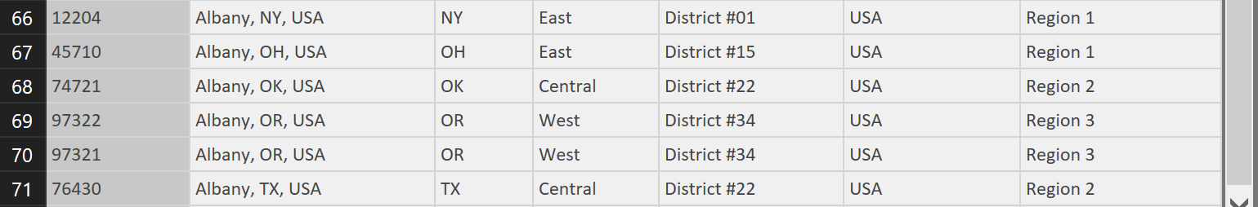
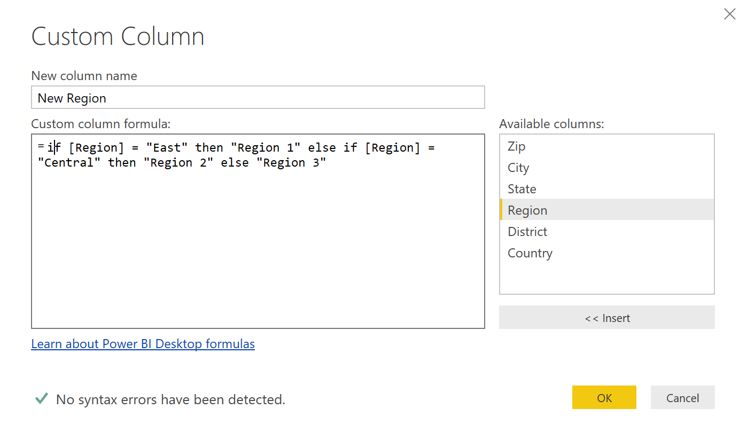
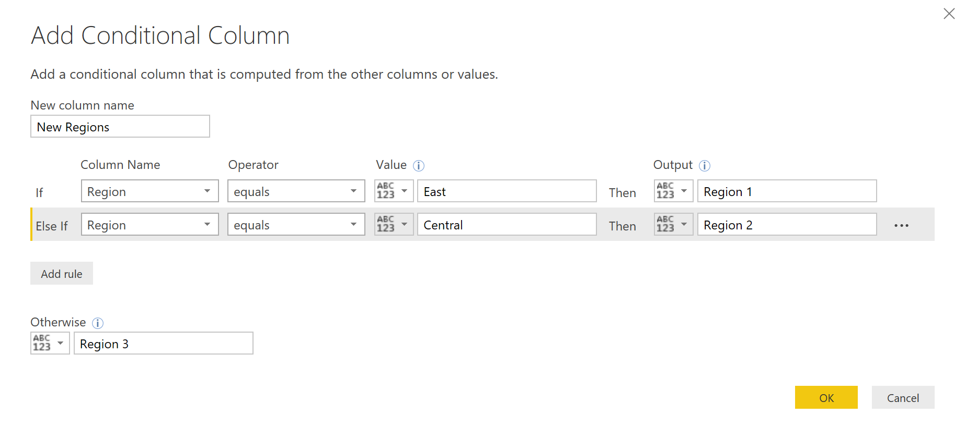
if … then … else using Conditional and Custom
Whether you use Conditional Column or Custom Column, the results are the same
1. How it reads in the formula bar when using the Conditional Column format
2. When using the Conditional Column format
Notes:
Main point here is how a Conditional Column looks to create the if..then..else statements and how that code appears in the Formula Bar vs if you added a Custom Column and wrote the code yourself. Same results.

Slide 48
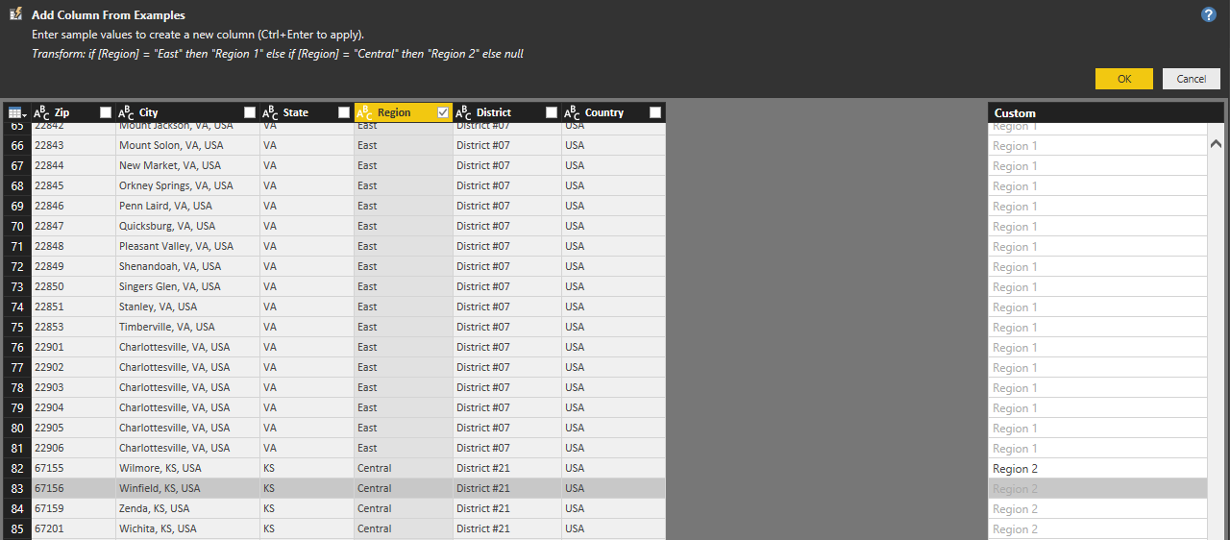
if … then … else using Columns From Examples
You use Columns From Examples to create if else logic
Notes:
Main point here is if you do not want to write conditional logic you can use Columns From Examples to achieve as similar result

Slide 49
Module 2 Lab:
Create and Update Dimension Table using M
Notes:
During this lab, if the class is interested, it is recommended to ask discuss the questions that are in the knowledge check, for this module (can be found in the appendix or here) Which relationships were already detected by Power BI?
Which table is the Fact Table?
Which are the dimensions tables?
Which type and direction are you going to choose?
Which type of schema have you created?

Slide 50
MODULE 3: Fact Table, Understanding Logic Operands & Functions

Slide 51
MODULE 3 OBJECTIVE
Understand Transformations
Understand Join operation
Create a fact table using transformations

Slide 52
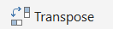
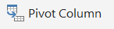
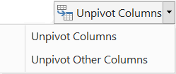
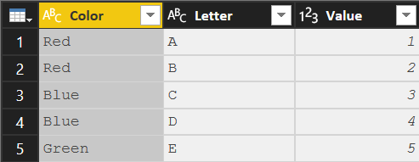
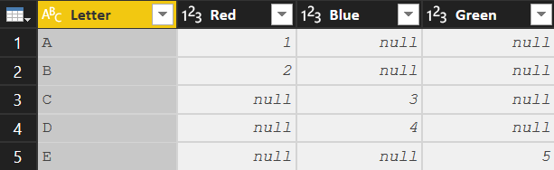
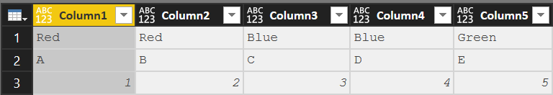
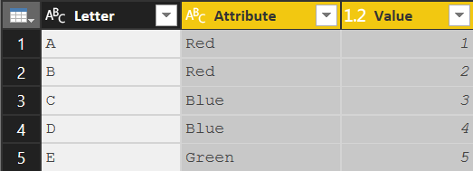
Key Transformations
Transpose
Convert Rows to Columns and Columns to Rows
Syntax: Table.Transpose(Previous)
Column headers are lost
To transpose column headers, demote them to data prior to transpose
Pivot Column
Convert Selected column of values into Column Headers
Syntax:
Table.Pivot(Previous,List.Distinct(Previous[Color]), "Color", "Value", List.Sum)
The values in [Color] column are converted to headers
The values in the [Value] column are filled in where applicable
Unpivot Columns
Convert Selected Column Headers into a column of values
Syntax:
Table.UnpivotOtherColumns(Previous, {"Letter"}, "Attribute", "Value")
The unpivoted column headers become the column [Attribute]
The unpivoted values become the column [Value]
Note: Previous => Name of the previous step in the query
Notes:
Transpose = taking everything that is a column and making it a row (all of the data what was a row becomes a column and what was a column becomes a row with the headers being lost.
Pivoting = in excel in a pivot table and something is on a row (i.e colors) I am now spreading those colors out to the right in their own column. Unpivoting is moving from columns to rows

Slide 53
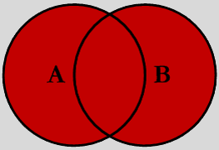
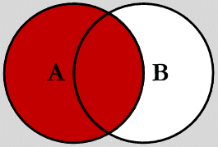


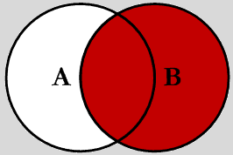
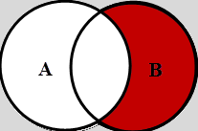
Join Kinds – Merge types
Full Outer (JoinKind.FullOuter)
Shows all of the rows from both queries.
Append Table= Like SQL “Union All”
Left Outer (JoinKind.LeftOuter) Default for Merge
Shows all rows in 1st query (A) and “paints” attributes from second query (B) based on matches in joined column(s).
Left Anti (JoinKind.LeftAnti) Shows ONLY rows in 1st (A) query where there is NO MATCH to 2nd query (B) based on joined column(s)
Inner (JoinKind.Inner)
Limits the rows to ONLY those which Match on joined column(s)
Right Outer (JoinKind.RightOuter) Shows all rows in 2nd (B) query and “paints” attributes from 1st query (A) based on matches in joined column(s)
Right Anti (JoinKind.RightAnti) Shows ONLY rows in 2nd (B) query where there is NO MATCH to 1st query (A) based on joined column(s)
Note: One or Multiple columns can be used to create the join
Notes:
A has 50 rows and B has 75 rows
Full Outer = You will have everything that matches so at least 75 rows if everything from A matches B. But if there are some that don’t match, we will get those additional rows.
Inner = We can have no more than 50 rows in the output and only those that share the same value (MATCH)
Left Outer = Only 50 rows with the additional columns that match from B (null if there is no match)
Right Outer = 75 rows from B and additional columns that match from A (null if there is no match)
Left Anti – is an UNMATCHED query: Give me all of the records in table A (Left) where there is NOT a match in table B (Right)
Right Anti – is an UNMATCHED query: Give me all of the records in table B (Left) where there is NOT a match in table A (Right)
Example = great to determine if every attribute in your dimension also resides in your fact table and vice versus.

Slide 54
Join Kinds – Other Combining Queries
Merge Combines attributes (columns) of two queries based on a joined columns(s)
Column(s) used for the join must be in both queries (can be one or more)
Both queries rerun with each execution
In Database terms, this is a JOIN
Append “Stack” records of two (or more) queries
Both (all) queries rerun with each execution
Like column headers must be named the same
Non-matching columns will be added to the right as extra colunns
Duplicate
Copies a query at a point in time (Save As)
Duplicate query can be modified independently without altering the original query
Executing the 2nd query (duplicate) does NOT execute the 1st (original) query
Reference Uses the output of one query as the INPUT in another query. (Link in a chain)
All subsequent changes made to 1st query affect the 2nd during refresh
When the 2nd query executes, it re-executes all the steps in the 1st query
Notes:
Merge = Based on the type of Merge we are combining attributes from two queries. Merge is like a VLookup
Append = stacking attributes based on column header names (i.e. Country in DIAD) is when you would copy and paste rows to a worksheet (insert cells, etc)
Duplicate = will only see the steps 1-5 from Query A if duplicate is done at that point. Whatever that query is at that point even if steps are added later in Applied Steps above the initial steps 1-5.
Reference = if I make a reference from query A after step 5 to a new Query B and make additional steps 6-10 then Query B will also be affected by those additional steps.

Slide 55
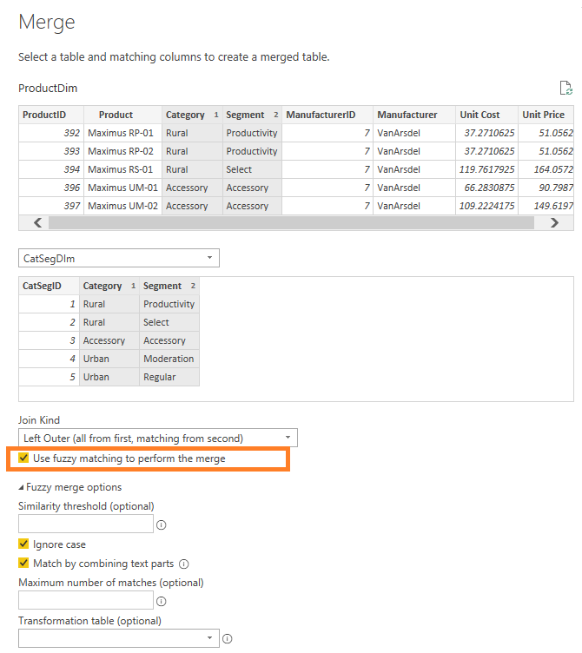
Fuzzy Merge allows you to apply Fuzzy Matching algorithms when comparing columns and try to find matches across tables being merged.
Fuzzy Merge
Notes:
https://powerbi.microsoft.com/en-us/blog/power-bi-desktop-april-2019-feature-summary/#fuzzyMerge
https://www.youtube.com/watch?v=I65YCrJWliw

Slide 56
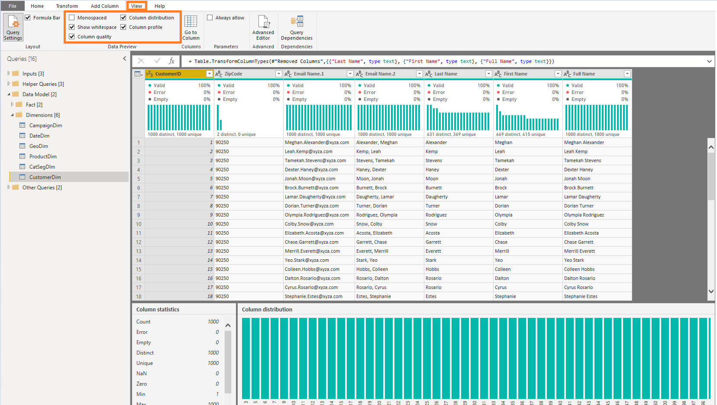
Data Profiling allows you to easily and quickly understand data distribution
Data Profiling
Column statistics – # of errors, empty, valid, duplicated and unique values. Value distribution measures such as Min/Max/Average/Median, etc.
Column distribution – Larger size version of the inline value distribution histograms, also including the ability to Keep or Remove values, which will generate the corresponding Filter Rows step in your query (“Equals” / “Does Not Equal” filters).
Notes:
Data Profiling allows you to easily find issues with your data within the Power Query Editor. In addition to the inline Column Quality bar and Value Distribution histograms
https://powerbi.microsoft.com/en-us/blog/power-bi-desktop-april-2019-feature-summary/#profiling

Slide 57
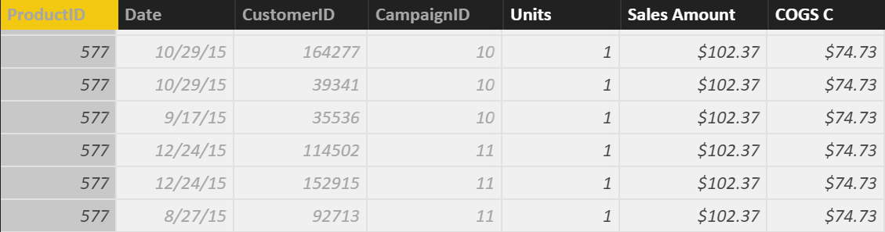
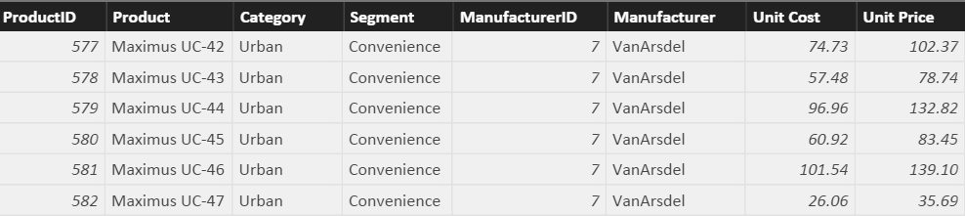
Row Context and Multiple Tables – RELATED Function
RELATED Function
Sales[COGS] = RELATED(ProductDim[Unit Cost]) * Sales[Units]
RELATED is just like VLOOKUP in Excel
Notes:
First Bring in the column. Let it resolve and then multiply
Demo:
In SalesFact Table write this formula: Sales[COGS] = RELATED(ProductDim[Unit Cost]) * Sales[Units]
(also available in Calculated Column Tab)
Note to instructor: Just like Vlookup but without all of the drama – No NA()

Slide 58
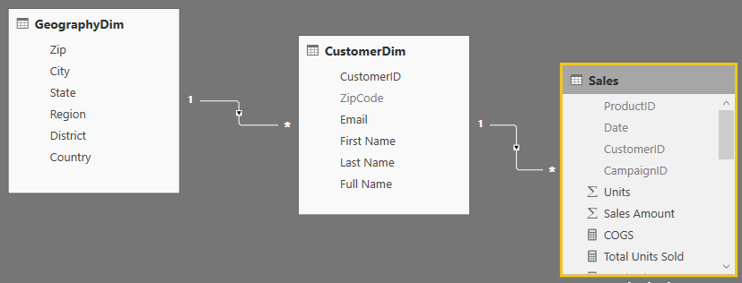
RELATED Function Example
RELATED Function
You could follow a chain of relationship from Many side to 1 side using RELATED
Sales [City State]= RELATED(GeographyDim[City]) & “, ” & RELATED(GeographyDim[State])
Notes:
This is an example of “Just because you can, does not mean you should”
Creating a calculated column like this on the fact table takes way too much memory when it could just as easily be placed on the GeographyDim table.
No Demo on this slide
Note to Instructor: If you need to aggregate back from 1 side to the Many side, there is a companion formula called RelatedTable – but we will cover that later.

Slide 59
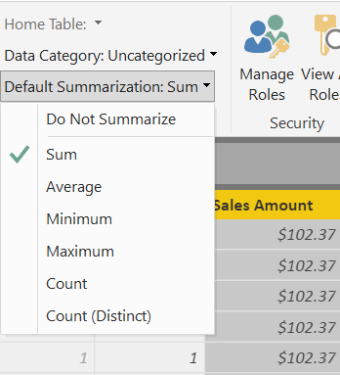
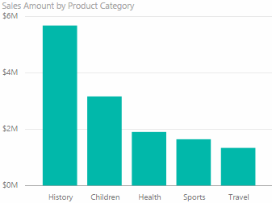
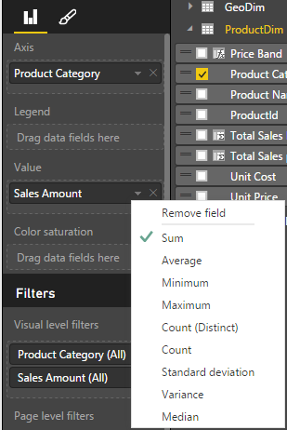
What is a Default Summarization?
Default Summarization
On the Modeling ribbon
For an individual visualization
Sales Amount is automatically summed for each category
You should set this summarization for all numeric fields in the Modeling ribbon
Create Sales amount units by Category
Notes:
DEMO: Show Default Summarization tab
Instructor Note:
Ask the participants why it works (ie. How does it know to Sum?).
When you drop a calculated column into the visual, Power BI creates Implicit Measure (using Default Summarization). In this case, the implicit measure is Sum of Calc COGS.
Bring in Sales Amount column from the Sales Fact Table into the value section of the graph on the top left hand side.
Instructor Note:
Creates Implicit Measure – Default Summarizations – we can change it.
Dropping a Text column into the Values – will create a count.
Revert this to a Sum on the sales amount at the end of the demo. We will be using the Sales Amount again and we want to make sure it is a Sum.

Slide 60
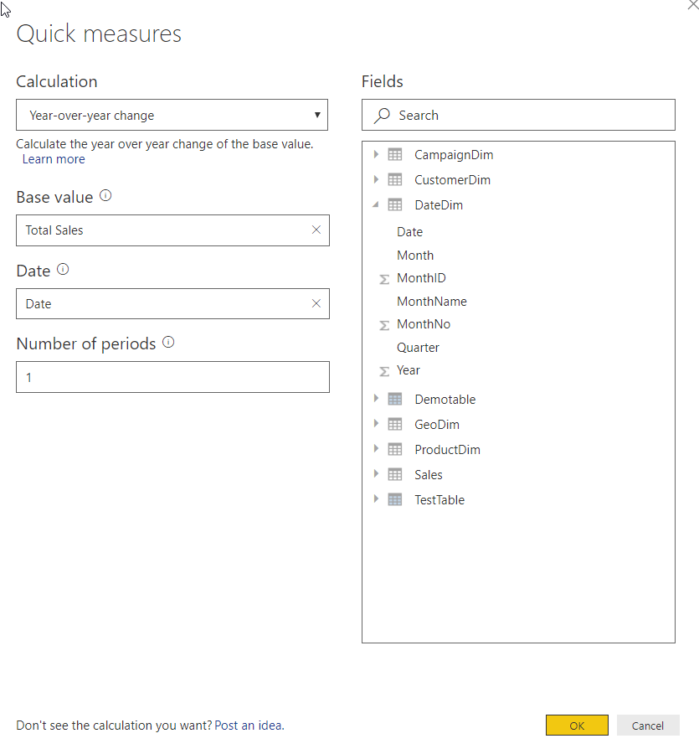
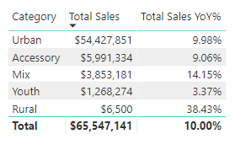
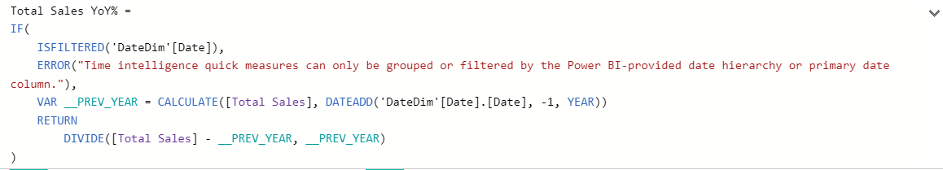
Quick Measures are wizard driven DAX calculations
Quick Measures
Right+Click a table and select Quick Measures
Select calculation type and fill-in parameters
DAX is generated automatically
Great way to learn DAX
See Quick Measure gallery: https://community.powerbi.com/t5/Quick-Measures-Gallery/bd-p/QuickMeasuresGallery
Notes:
DEMO: Create a Quick Measure in the data model
Note that the DAX has error handling, and my be more complex than the user would write themselves.

Slide 61
Module 3 Lab:
Import and Transform Create additional fact Table

Slide 62
MODULE 4: Parameters & Introduction to DAX

Slide 63
MODULE 4 OBJECTIVE
Understand what is DAX and how can it be used
Understand working with parameters

Slide 64
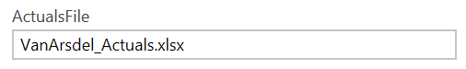
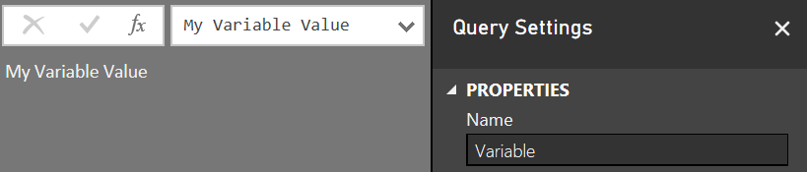


Variable and Parameters
M Variables
Query with a constant value, table or list result
Create with a new blank query
Query name is the Variable name to use in other queries
Type the variable value in the formula bar
Advanced Editor would look like this:
M Parameters
Parameters take Variables to the next level.
Parameters can be any VALID data type
The most common are hard keyed single, switchable values
The values list for a parameter can also come from a query that is formatted as a LIST
Parameter used as Source Input
Parameter Usage
Be Creative!
SQL Server
For Database Name
For Server (Switch Dev, Test, Prod)
“Where Clauses” in SQL Queries
To pull all Orgs, or just a single one
SharePoint Team site names
If they are based on a template, you can easily share queries
File Paths and File Names
Have a single place where you need to make a change

Slide 65


Custom Functions
Custom Functions help you re-use code
Create function using Blank query
Create function using Baseline query
Notes:
Can write M code to create functions
Can create a baseline query and create function using this query

Slide 66



User Enter Data to add a table on the fly. They make great mapping tables.
Enter Data
<- To add additional rows or columns later, click the gear icon.
Notes:
Enter Data is a function which allows you to create the equivalent of a “Linked Table” within the Query Editor.
They can be an easy way to create a manual Mapping table or a Change Log within the file.

Slide 67
DAX Level Set
DAX looks similar to Excel functions, but they have key differences
DAX is a very deep and elegant…
This class provides a base in DAX, but don’t expect to leave being able to write the most complex DAX patterns--they take practice.
Notes:
Let’s be real.
- DAX is easy to get started with (due to similarity to Excel)
- DAX mastery takes a lot of time to acquire
- Subtle differences in DAX formulas can have profound results!

Slide 68
Path to DAX Expertise
DAX Foundations
Evaluation Contexts
CALCULATE
Calculated Columns and Measures
Notes:
Even though this class is 200 this is really a 100 level DAX class
DAX answers are not “one size fits all” – we are trying to help you find some hidden gems

Slide 69
DAX Foundations
Calculated Column
Measure
Notes:
Calculated Columns and Measures are both written in the DAX Language.
A Calculated Column is evaluated as a new column in the table in which it resides and will not change value until the underlying data is refreshed.
Measures are calculations which do not have a result until they are used in a visualization. They may use sums, averages, minimum or maximum values, counts, or more advanced calculations; and they change value in response to your interaction with your reports.

Slide 70

What is a Calculated Column?
Calculated Column
Pro Tip: Always refer to a calculated column by its full name -> TableName[ColumnName]
Notes:
Used to add attributes that don’t exist in the source data
See this formula. This looks a lot like Excel
Demo:
In Product Dim Table add the above formula from the Tab called “Calculated Column”

Slide 71

Calculated Column in DAX
Calculated Column
Custom Column in “Query Editor”
Note: If given a choice, creating the column in “M” or “Query Editor” will give you better compression.
Notes:
DEMO: If a question comes up related to how to create a calculated column in ”M”, then do the following:
Open Query editor and create a calculated column using this formula:
if [Unit Price] <= 25 then "Low" else if [Unit Price] <=50 then "Medium" else "High“ M is case sensitive and the if/then/else syntax is different than Excel/DAX
Instructor Talking Point, if needed:
Once the column comes in it becomes like any other column in Power BI Desktop file
The column is compressed
There is a secondary processing for Calculated Columns – Which makes process times slower

Slide 72

Calculated Column – Accessing columns from other Tables in model
Calculated Column
Often you want to access columns from multiple tables to create a Calculated Columns
Let us say you want to calculate COGs, which is Units * Units Cost
Units Cost is in another Table

Slide 73
When is a Calculated Column Evaluated?
DAX Foundations
“Get Data” Phase
Model Creation Phase
Model
Enhancement
Phase
Visual
Building Phase
Create Query in “M”
Compress data
Auto detect relationships
Add calc. columns, Measures
Add missing relationships
Evaluate Measures and build each visual
Notes:
Note to Instructor: This has already been covered and is just reinforcing a concept covered in a previous slide.

Slide 74
DAX Foundations
Calculated Column
Measure
Notes:
Instructor Note: From the Definitive Guide to DAX (Russo, Marco and Ferrari, Alberto)
Calculated Column is just like any other column in a table and you can use it in rows, columns, filters, or values of a pivot table or any other report. You can use it to define a relationship, if needed. The DAX expression defined for a calculated column operates in the context of the current row of the table to which it belongs. Any reference to a column returns the value of that column for the current row. You cannot directly access te values of other rows. – Important concept is that a Calculated Column is computed during the processing and then stored into the model. The Calculated Columns occupy space in memory.
Measures are another way to define calculations but when you do not want to compute values for each row but, rather, you want to aggregate values from many rows in a table. A measure needs to be defined in a table but does not really belong to the table and can be moved from one to another without losing its functionality.
Differences between calculated columns and measures – even if they look similar, there is a big difference between these. The value of a Calculated Column is computed during data refresh and uses the current row as a context; it does not depend on user activity on the pivot table. A measure operates on aggregations of data defined by the current context. A measure always operates on aggregations of data under the evaluation context.

Slide 75

What is a Measure?
Measures
[Total Sales]=SUM(Sales[Sales Amount])
Measures are created using DAX
Place your Measures on a Fact table for best results
Pro Tip: When referring to a measure in other calculations, refer to it without a Table name: [MeasureName]
Notes:
DEMO:
From the Modeling Ribbon, show measure called Total Sales and that resolves to the same values as default summarization.
Formula: Total Sales = SUM(Sales[Sales Amount])
In the Measure tab, drop the Total Sales measure onto the graph on the right in the values section
Instructor Talking Points:
Explain the calculations in DAX vs Power BI:
On the graph on the top left, the calculations are done by Power BI implicitly.
The graph on the right, show the calculations on the right in DAX which are written, explicitly.
Instructor Note:
Talk about Home Tables. Even though it looks like Measures are in a Fact Table internally they are stored in a separate table called Measures Table
Always ensure the Home Table is a FACT table
Be sure the mention that measures should only be associated with FACT tables, and that measure names must be globally unique within the data model.
If class is interested, may be worth mentioning that the reason measure names must be unique is that they end up being associated with a hidden measures-only table that gets created in the data model

Slide 76
Measure, Use Case 1: Using One Measure in Another
Measures
Instead of writing this:
[Profit] = SUM(Sales[Sales Amount])-SUM(Sales[COGS])
Write this:
[Profit] = [Total Sales]- [Total COGS]
Allows re-use of measures
Formulas are much simpler to read
Notes:
Advantage to writing DAX
Simplify DAX by referencing other Measures
Quickly reference the list of measures from the formula bar by typing “[“ – As all Measures start with this character

Slide 77
Measure, Use Case 2: More Complex Calculations
Measures
[Profit Margin %] = [Profit] / [Total Sales]
Ratios are calculations that cannot be created using a Calculated Column or Default Summarization
Use DAX DIVIDE for built in error handling
[Profit Margin %] = DIVIDE([Profit] , [Total Sales])
Notes:
DEMO:
Profit Margin = Sales[Sales Amount] – Sales[Cogs]
Profit Margin % = DIVIDE([Profit Margin], Sum(Sales[COGS]) )

Slide 78
Measure, Use Case 3: More Complex Calculations Using Variables
Measures
MobileSalesLastYear =
VAR MobileProducts = FILTER(
ALL('CampaignDim'[Device]),
CampaignDim[Device]="Mobile"
)
VAR LastYear = SAMEPERIODLASTYEAR('DateDim'[Date])
RETURN
CALCULATE(SUM(Sales[Sales Amount]),MobileProducts,LastYear)
Allows re-use of variables
Formulas are much simpler to read
Notes:
DEMO:
Measure uses functions like ALL and SAMEPERIODLASTYEAR. These functions will be discussed in detail shortly.

Slide 79

Calculated Column vs. Measure - When to Use What
Calculated Column vs. Measure
Columns
Values
Slicer
Rows
Rule of Thumb for Calculated Column vs Measure
Calculated Column – Use in Page, Report & Visual Filters as well as Slicers, Rows and Columns
Measures - Use in Values section
Notes:
Values use either an implicit Measure or Explicit Measure (explicitly written DAX)

Slide 80
PATH to DAX Expertise
DAX Foundations
Evaluation Contexts
CALCULATE
Calculated Columns and Measures

Slide 81
DAX Function Types
Scalar Functions
Table Functions
Scalar functions return a Single value as an output
Ex. SUM(Sale[Sales Amount])
Table functions return a Table as an output
Ex. ALL(GeographyDim)
There are other ways to classify functions – By kind of operation they perform etc.
Notes:
Scalar is a fancy word for using a single coordinate in the evaluation
What if you want bring in a Table or List of values and apply your calculation to them?

Slide 82
Evaluation Context
There are two contexts under which calculations are evaluated
Row Context
Filter Context
Notes:
Two gods you can invoke in your DAX calculation
Can be blended in a single calculations

Slide 83

Row context in Calculated Column
Sales[COGS] = RELATED(ProductDim[Unit Cost]) * Sales[Units]
Formula is evaluated row by row
The context under which formula is evaluated for each row is called “Row Context”
Pro Tip: To accumulate up from Fact to Dimension, use RELATEDTABLE()
Notes:
Row context invoked when you refer to a column in a calculated column formula without an aggregation function surrounding it
Row Context – How many units sold in Row 1?

Slide 84
Evaluation Context
Both Calculated Columns and Measures are always evaluated under two contexts
Row Context
Filter Context
Notes:
Filter Context is defined by the Visual

Slide 85

Filter Context in Measures
Filter Context in a Measure – Example 1
[Total Sales] = SUM(Sales[Sales Amount])
Filter Context for current coordinate
Year = 2015,
State = HI,
Quarter = Q1
Formula is evaluated for each “Coordinate” in each visual
The context for each coordinate is called “Filter Context”
Notes:
Discuss the filter context for the selected cell
Think in terms of co-ordinates (lat/longitude)

Slide 86


Filter Context in a Measure – Example 2
Filter Context in a Measure
[Total Sales] = SUM(Sales[Sales Amount])
Filter Context : Year = 2015, Quarter = Q1
Filter Context : Year = 2015, Quarter = Q2
Notes:
Charts and Graphs also have Filter Context. EACH data point has a unique Filter Context

Slide 87
Filter Context in a Measure
Filter Context in a Measure
[Total Sales] = SUM(Sales[Sales Amount])
Better definition of above measure:
“Total Sales” – SUM of Sales[Sales Amount] column under a filter context
Notes:
A measure is not evaluated until it is in a Visual – and will be under a filter context

Slide 88


Filter Context and Multiple Tables
Filter context automatically propagates from Dim Table to Fact Table
Filtering the DateDim Table to Year = 2015 returns only Sales for 2015
Notes:
In a Uni-Directional relationship, the filter can only flow from the Dim to the Fact
In a BI-Directional relationship, the filter can flow each way.

Slide 89

Filter Context and Multiple Tables
Filter Context and Multiple Tables
Filters (Filter context) automatically propagate based on direction of arrows in relationships
Examples
Filter goes from DateDim to CustomerDim
Filter does not go from CustomerDim to DateDim
Notes:
In a Uni-Directional relationship, the filter can only flow from the Dim to the Fact
In a BI-Directional relationship, the filter can flow each way.

Slide 90

Filter Context and Multiple Tables – Right Arrow Direction
Filter Context and Multiple Tables
Cross filtering works properly
Arrow allows filters
Arrow allows filters
Filter goes from DateDim to CustomerDim
This is why the above Pivot table works
Notes:
Show going to the data model and updating the relationship from Single to Both (or back)
Toggle between this and the next slide
Why can’t I just enable all bi-directional relationships
They are expensive
Only turn them from Uni- to Bi- when absolutely necessary

Slide 91

Filter Context and Multiple Tables – Wrong Arrow Direction
Filter Context and Multiple Tables
Cross filtering does not work
Arrow allows filters
Arrow does not allow filters to flow to DateDim
Filter goes from DateDim to CustomerDim
This is why the Count of Month in the table above is incorrect
Notes:
See Barbara’ Blog on the many to many using key words (also note there is a custom Key Word text filter)

Slide 92
Evaluation Context Multiple Table – Summary and Take Aways
Evaluation Context and Multiple Tables
Row Context
Filter Context
Does not propagate automatically
Need to use
RELATED
RELATEDTABLE
Propagates automatically
Depends on direction of arrow in relationship diagram

Slide 93
Applications of Table functions
Table functions can be used 2 ways in Power BI Desktop
As an input to another DAX function
CALCULATE
Iterator functions
Calculated Tables
Notes:
Demo CALCULATED Table example in Power BI Desktop model
Call out the fact that CALCULATED Tables are just like a calculated column – Calculated during processing time or refresh time
You can use this table just like any other DAX in the model – You can create relationships etc.
Go to the Desktop and create a new Demo Table = ALL(GeographyDim) – duplicate with a separate memory footprint.

Slide 94
Basic TABLE functions
Return All Rows
Return Distinct Rows
Return Filtered Rows
ALL & variants
ALL, DISTINCT, VALUES
FILTER
There are more advanced Table functions, which we will not cover
Notes:
We will discuss three classes of Table function
No demo yet.

Slide 95
Basic Table functions – Return All Rows
The ALL function - Can take either Table or Columns in a Table as input
ALL with Entire Table
ALL with One Column
ALL with Multiple Columns
ALL(GeographyDim)
ALL(GeographyDim[Region]))
ALL(GeographyDim[Region],
GeographyDim[State])
Returns all rows all columns in Table
Returns all unique values of Column
Returns all unique combinations of Column values
Notes:
No Demo (already shown in previous demos)

Slide 96
Basic Table functions – ALL versions
There are several forms of the ALL function
ALL
ALLEXCEPT - Return all columns in a Table except 1 or more columns
ALLSELECTED – Return all values in a column selected by users in Slicers
ALLNONBLANKROW – Return all non-Blank rows
Notes:
We demonstrated these functions in the CALCULATE section
Table1 – has a duplicate row
When I write ALL on the whole table, I get the whole table
When I write ALL on the two columns of the table, it removes duplicates
Blank vs a mismatch
ALLEXCEPT - Overrides all context filters in the table except over the specified columns; useful when you want only one column on a table to be sliceable
ALLSELECTED – just like ALL, but if the column is specifically selected, then it respects the slicer
ALLNONBLANKROW – Just like ALL, but does not return any blank rows

Slide 97
Basic Table Functions – Return Distinct Rows
VALUES – Return all distinct values in a column or Table
(including blank rows)
DISTINCT - Return all distinct values in a column or Table
(not including blank rows)
Notes:
No Demo
If when you write VALUES and get a blank you may have Blank or MisMatch
If you change a VALUES to DISTINCT and you still have blank – then it is a real blank – NOT A MISMATCH
DISTINCT is more expensive as well
Blank vs a mismatch – If your model has Fact rows which do not match with dimensions, this is a mismatch – not a true blank.
HASONEVALUE: eturns TRUE when the context for columnName has been filtered down to one distinct value only. Otherwise is FALSE.

Slide 98
Basic Table Functions – Return Distinct Value
HASONEVALUE - Returns TRUE when the context for columnName has been filtered down to one distinct value only. Otherwise is FALSE
Header = IF ( HASONEVALUE ( ProductDim[Price Band] ),
CONCATENATE (“Report Header for Price Band : ",
VALUES ( ProductDim[Price Band] )),
"Overall Report")
SELECTEDVALUE - Returns the value when the context for columnName has been filtered down to one distinct value only. Otherwise returns alternateResult.
Header (SELECTEDVALUE) =
VAR selectedPriceBand =SELECTEDVALUE ( ProductDim[Price Band] )
RETURN
IF ( ISBLANK ( selectedPriceBand ), "Overall Report",
CONCATENATE ( "Report Header for Price Band: ", selectedPriceBand )
)
Notes:
The function HASONEVALUE Returns TRUE when the context for columnName has been filtered down to one distinct value only. Otherwise is FALSE.
The function SELECTEDVALUE returns the value of the column reference passed as first argument if it is the only value available in the filter context, otherwise it returns blank or the default value passed as second argument
Mostly used in slicer selection. E,g, measure is calculated when only one value is selected in slicer
https://www.sqlbi.com/articles/using-the-selectedvalue-function-in-dax/
HASONEVALUE: eturns TRUE when the context for columnName has been filtered down to one distinct value only. Otherwise is FALSE.
*************
To use when a customer wants to return different value depends on the result for example sum above 2.

Slide 99


Basic Table Functions – Return Filtered Set of Rows
FILTER(ALL(GeographyDim[Region], GeographyDim[State]), GeographyDim[Region] = “Central”)
Take all unique combinations of GeographyDim[Region], GeographyDim[State]
Filter down to the rows where GeographyDim[Region] = “Central”
Notes:
The Region = “Central” is in a ROW Context as it is not surrounded by aggregate function
******************
The region filter that should be created takes all the condition and applies calculate expression

Slide 100
When is a Measure Evaluated?
DAX Foundations
“Get Data” Phase
Model Creation Phase
Model
Enhancement
Phase
Visual
Building Phase
Create Query in “M”
Compress data
auto detect relationships
Add calc. columns, Measures
Add missing relationships
Evaluate Measures and build each visual

Slide 101

All of the queries in our file are dependent on the file being in a specified path
Module 4 Lab: File Source considerations
If you move the source file and try to refresh the queries you will receive an error
C:\ to File Share
Different folder location
To SharePoint
To OneDrive
Each query will need to be changed EACH time the file is moved
Creating Parameters with Dynamic Paths resolves this issue

Slide 102

Create Parameters
Module 4 Lab: Create Parameters
Actual File
Budget File
Path
Notes:
Explain the Suggested Values drop down field
StepxStep(Student Handout Slide 12)
Objective: Update file paths to use dynamic variables
From the Home Ribbon > Manage Parameters
Create a new Parameter
Parameter Name: Path
Type: Text
Current Value = C:\Power BI_Adv_M\
Important that this matches the file name that the student has on their C Drive. If they don’t have the underline but they have spaces in the folder name then this needs to match their folder
Create a new Parameter
Parameter Name: Actuals_File
Type: Text
Current Value = VanArsdel_Actuals.xlsx
Create a new Parameter
Parameter Name: Budget_File
Type: Text
Current Value = VanArsdel_Budget.csv
Update the text files to ensure the parameter names are consistent

Slide 103


Use blank query to create Dynamic Path
Module 4 Lab: Dynamic Path to Excel Source File
Uses Blank Query
Populate Advanced Editor of query with text from file provided
For each query which uses the Excel source, update the Source (applied step) with the new variable name =Actuals_Path
Notes:
StepxStep(Student Handout Slide 13)
Objective: Create a query to validate if source is Web or Local and resolve path
Create a new blank query
Query Name: “Actuals_Path”
Open Advanced Editor and copy the text from the Actuals_Path.txt
If you need to troubleshoot:Text as shown in slide (white box) with the correction above
Update Source Applied Step to use Resolved Path = “Actuals_Path” to all of the following queries:
CampaignDim
CustomerDim
ProductDim
CatSegDim
DateDim
GeoDim
SalesFact

Slide 104


Use the Actuals_Path query as a variable in other queries
Module 4 Lab: Dynamic Path to Excel Source File
In Advanced Editor, update the Excel source to the new Actuals_Path source.
Original
Updated
Notes:
(Student Handout Slide 14)
You can also do this in Query Editor using the Applied Steps.

Slide 105


Follow a similar patter to make the Budget CSV file dynamic
Module 4 Lab: Dynamic Path to CSV Source File
Uses Blank Query
Populate Advanced Editor of query with text from file provided
For each query which uses the Excel source, update the Source (applied step) with the new variable name =Budget_Path
Notes:
StepxStep(Student Handout Slide 15)
Objective: Update CSV file paths to use dynamic variables
Create a new blank query
Query Name: “Budget_Path”
In Advanced Editor
Copy in text from Budget_Path.txt
Update Source Applied Step to use ResolvedBudgetPath = “Budget_Path” for the following Queries:
BudgetFact
BudgetFact_Data

Slide 106


Create a function to get number of days from start of year
Module 4 Lab: Custom Function
Uses Blank Query
Populate Advanced Editor of query with text from file provided
Invoke the custom function from Sales table. This will provide the number of days from start of year for each transaction
Notes:
StepxStep(Student Handout Slide 16)
Objective: Create a custom function
Create a new blank query
Query Name: “fn_DaySinceYearStart”
In Advanced Editor
Copy in text from Number_Days.txt
Create a new Parameter
Parameter Name: TransactionDate
Type: Date
Current Value = 1/1/2011
Update Sales query. Add Column -> Invoke Custom Function
New Column Name: DaysFromYearStart
Function query: fn_DaySinceYearStart
Transaction Date = Date

Slide 107


Use Enter Data to create a Change Log
Module 4 Lab: Create a Change Log
Create a table within query to house the change log
Name the query Change Log
Update table each time a change is made to the code
If you decide to load file to data model, then you have the ability to report on current version and last update date
Report
Notes:
You can add rows and columns to the Query using the gear next to Source
(Student Handout Slide 17)

Slide 108
Module 4a Lab - bonus
Create a MEASURE for Total Units Sold
HINT: The formula will probably use SUM()
Create a CALCULATED COLUMN on the fact table that shows product category and campaign traffic channel combined
Example: Urban, Organic Search
It is fairly easy to see that the CALCULATED COLUMN is working. Create some visuals that allow you to confirm that the Total Units Sold MEASURE is working right
Notes:
Just because you can doesn’t mean you should add a calculated column to the fact table.
Insure the instructors know to create a table with the new field and measure, then show that you can create the same visual by dragging the two "related" fields into the a table with the units. Same visual, no expensive calculated column
Expected results:
1. Total Units Sold = SUM(Sales[Units])
2. Category, Campaign = RELATED(ProductDim[Category]) & ", " & RELATED(CampaignDim[TrafficChannel])
3. Create a table (or column chart, or whatever) and compare the explicit measure that was just created with the implicit measure from pulling in Units. Talk about how you might go about verifying a more complex measure.

Slide 109
MODULE 5: Working with Functions, DAX CALCULATE, Custom functions

Slide 110
MODULE 5 OBJECTIVES
Understand working with functions
Understand the basics of the CALCULATE formula

Slide 111
PATH to DAX Expertise
DAX Foundations
Evaluation Contexts
CALCULATE
Calculated Columns and Measures
Notes:
Evaluation Context – Single biggest reason that people give up on DAX
Want to Simplify the Evaluation Context

Slide 112


Why is CALCULATE Useful?
CALCULATE
You create a report of breakdown of Sales by Month
Typical Business Question:
Provide a break out of this Sales from Desktop
Notes:
In Excel, there are SUMIF and SUMIFS functions – Calculate give you that flexibility and much more as it can be used with ANY Aggregation/Calculation
MYR – Drill to one Department’s data – and change the shape and it will all still work

Slide 113
Here is how you do it with CALCULATE
CALCULATE
[Desktop Sales] = CALCULATE([Total Sales], CampaignDim[Device] = "Desktop")
Use CALCULATE function to create a Measure which filters down to Desktop Sales
Notes:
Note that even if you apply a “Device” Slicer to this page, the measure [Desktop Sales] will always show Desktop

Slide 114
Anatomy of CALCULATE
CALCULATE
CALCULATE(Expression, [Filter 1], [Filter 2]…..)
Filter Arguments
EXPRESSION used as the first parameter is essentially the same as a measure
CALCULATE works differently from other DAX functions
The second set of arguments, i.e. the “Filter arguments,” are evaluated and applied first
Then the Expression is evaluated under new “Filter Context"
Notes:
ALL Filters arguments are ANDs – FILTERS ARE CALCULATED FIRST (to filter the rows), then the math is applied

Slide 115
CALCULATE – The Most Important Function in DAX
CALCULATE – Add Filter
4 Key functions that CALCULATE can do:
Add Filter
Ignore Filter
Update Filter
Convert Row Context to Filter Context
Notes:
Transition slide

Slide 116

CALCULATE – Add Filter
[Desktop Sales] = CALCULATE([Total Sales], CampaignDim[Device] = "Desktop")
[Tablet Sales] = CALCULATE([Total Sales], CampaignDim[Device] = “Tablet")
[Mobile Sales] = CALCULATE([Total Sales], CampaignDim[Device] = “Mobile")
*When the Device Slicer is selected, only “Total Sales” changes.
Notes:
Demo: Table from “Calculate-Add” report
Note the effect that the Year Slicer has on the table (All items change)
When the Device Slicer is selected, only “Total Sales” changes.
Filter Context : Jan + 2015
Jan + 2015 + Desktop
Jan + 2015 + Tablet

Slide 117
CALCULATE – The Most Important Function in DAX
CALCULATE – Ignore Filter
4 Key functions that CALCULATE can do
Add Filter
Ignore Filter
Update Filter
Convert Row Context to Filter Context

Slide 118


CALCULATE – Ignore an Existing Filter
[Total Sales All Geo] = CALCULATE([Total Sales], ALL(GeographyDim))
*Ignore filter on ANY column from the GeographyDim table, but allows filters from Year
Notes:
Optionally you can talk about the next three slides and then go into a demo to show all 3 in action instead of demoing each individually.
DEMO “Calculate- Ignore” Tab:
The table visualization, with each slide, expose the related column
Expose measure called [Total Sales All Geo] – Ignore filter on ANY column from the GeographyDim table, but allows filters from Year
Discuss that this measure can be used to calculate a % of Total measure

Slide 119


CALCULATE – Ignore an Existing Filter
[Total Sales All States] = CALCULATE([Total Sales], ALL(GeographyDim[State]))
*Ignore filter on the STATE column from the GeographyDim table, but allows filters from Year
Notes:
DEMO “Calculate- Ignore” Tab:
The table visualization, with each slide, expose the related column
Expose measure called [Total Sales All State] – Ignore filter on the STATE column from the GeographyDim table, but allows filters from Year
Slice on City (Aberdeen is good)

Slide 120


CALCULATE – Ignore Existing Filter
[Total Sales All Selected States] = CALCULATE([Total Sales], ALLSELECTED(GeographyDim[State]))
*Ignore filter on the STATE column from the GeographyDim table, but allows filters from Year
Notes:
DEMO “Calculate- Ignore” Tab:
The table visualization, with each slide, expose the related column
Expose measure called [Total Sales All Selected State] – Ignore filter on the STATE column from the GeographyDim table, but allows filters from Year
Slice on City (Aberdeen is good), then select multiple State, see that the measure now only displays the total for selected states.

Slide 121
CALCULATE – The Most Important Function in DAX
CALCULATE – Update Filter
4 Key functions that CALCULATE can do
Add Filter
Ignore Filter
Update Filter
Convert Row Context to Filter Context

Slide 122


CALCULATE – Update Existing Filter
[2014 Sales] = CALCULATE([Total Sales], DateDim[Year] = 2014)
*Ignores filter on the Year Slicer
Notes:
DEMO “Calculate- Update” Tab:
The measure called [2014 Sales] – Ignores filter on the Year Slicer.

Slide 123
CALCULATE – The Most Important Function in DAX
CALCULATE – Convert Row Context to Filter Context
4 Key functions that CALCULATE can do
Add Filter
Ignore Filter
Update Filter
Convert Row Context to Filter Context
Let’s investigate what we mean by Filter Context
Notes:
Transition to Evaluation Contexts: Row & Filter

Slide 124
DAX Iterator Functions Take Advantage of Evaluation Context
DAX Iterator Functions
Iterator Functions
Creates a row context by iterating over a table that you specify
Ex. SUMX
Notes:
The table could be calculated ALL(DimGeography[State]) or a table in the data model DimGeography

Slide 125
Table Functions Application – Iterators
[COGS] = SUMX(Sales, Sales[Units] * RELATED(ProductDim[Unit Cost]))
Argument 1
Argument 2
Notes:
An iterator function takes two arguments – we will walk through this example over the next couple of slides

Slide 126

Table Functions Application – Iterators
[COGS] = SUMX(Sales, Sales[Units] * RELATED(ProductDim[Unit Cost]))
Argument 1
Iterate through each row in Argument 1
Sales
Notes:
Like a virtual calculated column, but don’t need to perpetually keep the column.
Argument 1 – iterate thru each of the columns in the table argument
****************************************
Gets the value of the unit cost in the table has to do the multiplication for each row
It gets the value of cogs essentially
Calculated column needs space, this why create the SUMX instead

Slide 127


Table Functions Application – Iterators
[COGS] = SUMX(Sales, Sales[Units] * RELATED(ProductDim[Unit Cost]))
Argument 2
Sales
ProductDim
Notes:
Perform the calculation for each row in the table argument

Slide 128

Row Context in a Measure – Iterator Functions
[COGS] = SUMX(Sales, Sales[Units] * RELATED(ProductDim[Unit Cost]))
SUM it up
SUM up list obtained
Notes:
Sum the results of all the rows.
Note: This calculation respects the Filter Context of the visual
This example is effectively SumProduct in Excel
****************
Sum operates on specific column

Slide 129
Why Can an Iterator be a Better Approach then a Calculated Column?
Iterators
You avoid creating a Calculated Column
Let us see the impact of a Calculated Column Called COGS on Data model with 100K rows - What if we have 10 M rows?
Iterators help you avoid several “Intermediate Calculated Columns”
Notes:
DEMO: In your working copy of “Student Modeling Pre-class.pbix” where you have the calculated column [COGS] –
* Save the file and note the size for the class
* Remove the [COGS] calculated Column and re-save the file.
* Note that the file size is about 8% smaller. While file size is not an exact measure of memory use, it is a proxy that most students understand.

Slide 130
CALCULATE – Converting Row Context to Filter Context (Example 1)
DAX Foundations
Sales velocity Segment = IF(
SUMX(RELATEDTABLE(Sales), Sales[Sales Amount])>=200000,
“High Velocity”,
“Low Velocity”)
Sales Velocity (Using CALCULATE) = IF (
CALCULATE(SUM(Sales[Sales Amount])) >= 200000,
"High Velocity",
"Low Velocity")
Another way to do Dynamic Segmentation
This method does not use Iterators
Instead it uses CALCULATE to convert Row Context to Filter Context
Notes:
Walk through demo:
Go to ProductDimTable
Create a column = SUM(Sales[Sales Amount]) – This will show total sales for the entire data model not taking the row context into account.
Show the first Calculated Column, the SUMX and RELATEDTABLE functions transfer row context to filter context.
In the second formula wrapping the SUM in a CALCULATE does the same thing.

Slide 131
Other Iterator Functions
AVERAGEX , PRODUCTX, MINX, MAXX– All work the same way as SUMX
RANKX – Works similar to SUMX, but slightly more complex (more options)

Slide 132
Table Functions – Summary and Application
Table functions can be used in 2 ways in Power BI Desktop:
As an input to another DAX function
CALCULATE
Iterator functions
Calculated Tables
CALCULATE is one of the primary places where Table functions are used

Slide 133
CALCULATE – Steps in Evaluating the CALCULATE Function
CALCULATE
CALCULATE(Expression, [Filter1], [Filter2]…..)
Step1 : Copy the current filter context
Step 2: Add new filters if any
Step 3: Update/ignore existing filters if any
Step 4: Convert row context to filter context
Step 5: AND all filter conditions to create new filter context
Step 6: Evaluate the Expression
Step 7: Return back to original filter context
Notes:
ALL Filters arguments are ANDs – FILTERS ARE CALCULATED FIRST (to filter the rows), then the math is applied
Within one Filter argument, you can use the double pipe “||” to “or” conditions together. See the Example in YTD Revenue.

Slide 134
Introducing Time Intelligence – There is an App for that!!
Advanced DAX – Time Intelligence
[SalesYTD Easier] =
CALCULATE (
[Total Sales],
DATESYTD(DateDim[Date])
)
This allows you to write the formula without being a DAX guru!
Microsoft is continuously improving Time Intelligence functions to make it simple to use
Time Intelligence functions are your friends – They will save you time!
Notes:
****************
Which has the better result? Given the option use calculate, same results and performance

Slide 135
Advanced DAX – Month over Month
Total Sales Last Month =
CALCULATE([Total Sales],
PREVIOUSMONTH(DateDim[Date]))
MoM =
DIVIDE([Total Sales] - [Total Sales Last Month],
[Total Sales Last Month])
DAX has several shortcut Time Intelligence functions
Notes:
Additional calculations to discuss commonly used scenarios
Calculates based on same day in prior month
MoM – Month over Month
*****************
Best practice – if there is division use Divide

Slide 136
Advanced DAX – Monthly Active Users
[Monthly Active Users] =
CALCULATE(
SUMX(VALUES(Sales [CustomerId]),1),
ALL('DateDim'),
DATESINPERIOD('DateDim'[Date],
LASTDATE('DateDim'[Date]), -1, MONTH)
)
Sumx vs DistinctCount of CustomerID
SUMX can be more performant
Notes:
Another commonly used scenario
Calculates based on same day in prior month – Discuss usage of DATESINPERIOD and LASTDATE
***************
Add more steps to calculate and how it adds up to this result

Slide 137
Other Time Intelligence Functions
Advanced DAX – Time Intelligence
DATESINPERIOD
DATESYTD
DATESQTD
NEXTMONTH NEXTYEAR
PREVIOUSYEAR PREVIOUSMONTH SAMEPERIODLASTYEAR
PARALLELPERIOD
Pro Tip: Learn about Time Intelligence functions - https://msdn.microsoft.com/en-us/library/ee634763.aspx

Slide 138
KNOWLEDGE CHECK Module 6
Can I parse advanced DAX formulas?
What are some standard DAX patterns?
Which time intelligence functions are built-in to DAX?

Slide 139
KNOWLEDGE CHECK Module 5
What are the different kinds of evaluation contexts?
When are filter or a row contexts present?
Which functions are commonly used to modify existing evaluation contexts?

Slide 140
MODULE 5 Lab:

Slide 141
MODULE 6: Modeling with Power BI & Optimization techniques

Slide 142
MODULE 6 OBJECTIVES
Gain familiarity with basic data modeling for business scenario
Learn some best practices for working with Power BI

Slide 143
Data Modeling
An inefficient model can completely slow down a report, even with very small data volumes
GOALS
Make the model as small as possible
There are valid reasons to bend this rule
Schema supports the analysis
Relationships are built purposefully and thoughtfully

Slide 144
Move calculations to the source
Scenario
Many DAX calculated columns with high cardinality
Why is it undesired?
Calculated columns don’t compress as well as physical columns
Proposed Solution
Perform calc in Power Query, ideally push down
Customize source query for non foldable transforms
Notes:
This slide emphasis learnings from Slide 26-28 – importance of compression

Slide 145
Remove unused tables and columns
Scenario
Model contains tables/columns that are not used for reporting/analysis or calculations
Why is it undesired?
Increases model size
Increases time to load into memory
Increases refresh time
May affect usability
Notes:
This slide emphasis learnings from Slide 26-28 – importance of compression

Slide 146
Avoid high precision/cardinality columns
Scenario
Model contains columns at a higher precision than needed for analysis e.g. datetime in milliseconds, weight to 6 decimal places
Model contains columns that are highly unique
Why is it undesired?
Less compression with high precision/cardinality
Increases time to load into memory
Increases refresh time
Proposed Solution
Remove if not needed
Reduce precision
Split datetime into date and time
Notes:
This slide emphasis learnings from Slide 26-28 – importance of compression

Slide 147
Use integers instead of strings
Why is it undesired?
Strings use dictionary encoding, integers use run length encoding which is more efficient
Proposed Solution
Check data types and set to integer if known to be numerical
Notes:
This slide emphasis learnings from Slide 26-28 – importance of compression

Slide 148
Use integer surrogate keys, pre-sort them
Power BI compresses rows in segments of millions of rows
Integers use Run Length Encoding
Sorting will maximize compression when encoded as it reduces the range of values per segment
Notes:
This slide emphasis learnings from Slide 26-28 – importance of compression
Default Segment Sizes:
AS Azure: 8 million
SSAS: 8 million
Premium: 1 million
Shared: 1 million
PowerPivot: 1 million

Slide 149

Be careful with bi-directional relationships
Scenario
Most relationships in the model are set to bi-directional
Why is it undesired?
Applying filters/slicers traverses many relationships and can be slower
Some filter chains unlikely to add business value
Proposed Solution
Only use bi-di where the business scenario requires it
Notes:
This slide emphasis learnings from Slide 12– use bi-directional filtering with caution

Slide 150

Set Default Summarization
Scenario
Numeric columns in model that are purely informational (e.g. Account ID)
Default summarization is Sum
Why is it undesired?
Power BI will try to sum the number when dropped into visuals.
Detailed tables/matrixes can be slower
Proposed Solution
Set the default summarization to None
Notes:
Fields like Year, which are numeric, but you do not want to summarize, set the global Default Summarization on the Modeling Ribbon
We will deep dive into default summarization in Slide 62

Slide 151
Best Practices with DAX Calculated Columns
Best Practices – Calculated Columns
Whenever possible, DAX helper columns should be avoided. Each “Helper Column” will consume RAM
Create a calculated column in the Dim Table as opposed to in the Fact Table
Move calculated columns to “M” if you can
Notes:
Instructor Talking Point,
Best Practice is to create a calculated column at the HIGHEST level of granularity - in the highest dim

Slide 152
Use variables instead of repeating measures
Consider the following DAX expression:
Ratio = IF([Total Rows] > 10, SUM(Revenue) /[Total Rows], 0)
Faster DAX:
VAR totalRows = [Total Rows];
Ratio = IF(totalRows > 10, SUM(Revenue) / totalRows,0)
In the first expression, since measures are calculated on the fly, the [Total Rows] expression gets calculated twice, first for the condition check and then for the true condition expression
Instead of calculating the same expression multiple times, the resulting measure value can be stored in a variable and variable reference can be used wherever required
Notes:
By using a variable, you can get the same outcome, but in a more readable way. In addition, the result of the expression is stored in the variable upon declaration. It doesn’t have to be recalculated each time it is used, as it would without using a variable. This can improve the measure’s performance.
https://docs.microsoft.com/en-us/dax/var-dax

Slide 153
Use DIVIDE() instead of /
DIVIDE() function has 3rd extra parameter which is returned in case of denominator being zero
It internally performs check to validate if the denominator is 0
There is no need to use IF condition along with '/' operator to check for invalid denominator
DIVIDE() also checks for ISBLANK()
Note: If it is certain that the denominator value would not be 0, then it is better to use '/' operator without any IF check since DIVIDE() function would always perform an IF check internally
Notes:
Emphasizing what is covered in Slide 66

Slide 154
Calculate ratios efficiently
Use (a-b)/b with variables instead of a/b – 1 or a/b*100 – 100
We can achieve the same performance by using variables and using (a-b)/b to calculate ratio
If both a and b are blank values, then (a-b)/b would return blank and would be filtered out where as a/b – 1 would return -1 and increase query space
Notes:
As covered in Slide 133, 134 and 135 this is a combination of using variables, using DIVIDE function and creating efficient measures where blanks are filtered out improving query efficiency

Slide 155
Don’t change blanks to zeros or other values
Sometimes people replace blanks with zeros or other strings
Power BI automatically filters out all the rows with blank values from query results
If the blanks are replaced, the query space is greatly increased
Notes:
Typically data modelers convert blanks to zeros:
While loading data in Power Query
In Measures to display 0 instead of blanks slowing down the measure

Slide 156
Use SELECTEDVALUE() instead of HASONEVALUE()
A common pattern is to use HASONEVALUE() to check if there is only one value present for a column after applying slicers and filters and then use VALUES(ColumnName) DAX function to get the single value
SELECTEDVALUE() performs both the above steps internally and gets the value if there is only one distinct value present for that column or returns blank in case there are multiple values available
Notes:
SELECTEDVALUE AND HASONEVALUE is discussed in slide 107
The function SELECTEDVALUE returns the value of the column reference passed as first argument if it is the only value available in the filter context, otherwise it returns blank or the default value passed as second argument
Mostly used in slicer selection. E,g, measure is calculated when only one value is selected in slicer
https://www.sqlbi.com/articles/using-the-selectedvalue-function-in-dax/

Slide 157
Use SELECTEDVALUE() instead of VALUES()
VALUES() returns error in case it encounters multiple values. Normally, users handle it using Error functions which are bad for performance
Instead of using that, SELECTEDVALUE() must be used which is a safer function and returns blank in case of multiple values being encountered
Notes:
This is a follow up to slide 139.
Typically HASONEVALUE and VALUES are used together. Instead you can use SELECTEDVALUE

Slide 158
Use DISTINCT() and VALUES() functions consistently
Power BI adds a Blank value to the column in case it finds referential integrity violation
For direct query, Power BI by default adds blank value to the columns as it does not have a way to check for violations
Difference :
DISTINCT(): Does not return blank which is added due to integrity violation. It includes blank only if it is part of original data
VALUES(): It includes blank which is added by Power BI due to referential integrity violation
The usage of either of the function should be same throughout the whole report
Power BI recommends to use VALUES() in the whole report if possible and blank value is not an issue
Notes:
Blank() is covered in Slide 106
Values() is covered in Slide 107
https://www.sqlbi.com/blog/marco/2011/03/08/difference-between-distinct-and-values-in-dax/

Slide 159
Avoid using IFERROR() and ISERROR()
IFERROR() and ISERROR() are sometimes used in measures
These functions force Power BI engine to perform step by step execution of each row to check for errors as there is currently no way which directly states which row returned the error
FIND() and SEARCH() DAX functions provide an extra parameter which can be passed and is returned in case of the search string not present – avoids use of IFERROR/ISERROR
Both of this functions are currently also used to check for divide by zero error or along with values to check if more than one values are returned.
Can be avoided by using the correct DAX functions like DIVIDE() and SELECTEDVALUE() which performs the error check internally and returns the expected results
Notes:
Usage example
Measure= IFERROR([Measure 1] / [Measure 2], 0, [Measure 1] / [Measure 2])
Or in a calculate column:
=IFERROR(SEARCH(“RP*”,DimProduct[Product]),-1)
If DAX measure has multiple steps and there is a check for error. E.g. If there is an error do X else do Y. Logically this is correct but slows down the measure

Slide 160
Use ISBLANK() instead of =BLANK() check
Use inbuilt function ISBLANK() to check for any blank values instead of using comparison operator “= Blank()”
ISBLANK() is faster
Notes:
https://xxlbi.com/blog/different-blanks-in-dax/
https://www.sqlbi.com/articles/blank-handling-in-dax/

Slide 161
Use FILTER(ALL(ColumnName))
To calculate measures ignoring all the filters applied on a column, use All(ColumnName) function along with the FILTER instead of Table or VALUES(). Eg: CALCULATE([Total Sales], FILTER(ALL(Products[Color]), Color = 'Red’))
Directly applying filters using expressions and not using FILTER function behaves in the same way as mentioned above and it internally translates to use ALL function in the filter
Eg: CALCULATE([Total Sales], Products[Color]= 'Red’)) ->
CALCULATE([Total Sales], FILTER(ALL(Products[Color]), Products[Color]= 'Red’))
It is always better to apply filters at desired column than the whole table
Always use ALL along with FILTER function if there is no specific need to keep current context
https://pbidax.wordpress.com/2016/05/22/simple-filter-in-dax-measures/
https://www.sqlbi.com/articles/filter-arguments-in-calculate/
Notes:
Refer to Slide 81-83

Slide 162
Do not use scalar variables in SUMMARIZE()
SUMMARIZE() traditionally used to perform grouping of columns and get the resulting aggregations along with it
It is recommended to use SUMMARIZECOLUMNS() function which is a newer more optimized version
SUMMARIZE function should only be used to get just the grouped elements of a table without any measures/aggregations associated with it.
E.g. SUMMARIZE(Table, Column1, Column2)
Notes:
https://www.sqlbi.com/blog/marco/2020/02/02/using-summarizecolumns-instead-of-summarize-in-dax-powerbi-ssas-tabular/
https://dax.guide/summarizecolumns/
https://docs.microsoft.com/en-us/dax/summarizecolumns-function-dax
SummarizeExample =
SUMMARIZECOLUMNS (
DateDim[Year],
ProductDim[Price Band],
"Sales Amount", SUMX ( Sales, Sales[Units] * RELATED ( ProductDim[Unit Cost] ) )
)
*********************************
Even when only powerview was available it was using the summarizecolumns. It is more optimized than the Summarize(). This is a great performance improvement.
Look at the new functions that come up and see which performance enhancements needed.

Slide 163
Avoid using ADDCOLUMNS() in measure expressions
Measures are calculated in iterative manner by default
If measure definitions use iterative functions like AddColumns, it create nested iteration which downgrades the performance
Notes:
https://www.sqlbi.com/articles/best-practices-using-summarize-and-addcolumns/

Slide 164
Avoid string manipulation in measures
Slows down measures
Work is done in calculation engine
Notes:
String manipulation example: To deal with data not in the right format. E.g. Usernames, getting a substring (remove @emailaddress) to use in a measure. This reduces measure performance
We have used string manipulation to create header (SelectedValue page in report). This is ok, because it’s a simple measure. But if you dealing with large volume of data, reduces performance. Be careful where you use it.
*******************
Example of taking a measure value and show if it is increasing or decreasing

Slide 165
KNOWLEDGE CHECK DAX Best Practice
Which of these are best practice ?
isBlank() or comparison operation =Blank()
SELECTEDVALUE() or HASONEVALUE()
DIVIDE() or IFERROR()
Using variables or repeating calculations

Slide 166
Consider subsets for very large models
Scenario
Large model – hundreds of tables and tens of GB
Large high grain fact tables – millions to billions
Why is it undesired?
Aggregating/measures across large facts can affect performance
Large models become harder to maintain and use ad-hoc
Proposed Solution
Consider aggregations and composite models features
Build manual summary tables with smart measures
Create smaller models for the most common business cases
Notes:
Companies build a mega model to answer all questions. If you build one mega model – model becomes extremely large impacting performance (both in shared and premium capacity).
In this scenario – might be good idea to break down the model into smaller models. Maybe Exces use smaller subset or aggregated data. So it maybe be a good idea to break model based on consumers and have multiple models answering different questions at different levels.
Not covered here – In Power BI Service maybe good idea to have a Premium workspace for Exces and different workspace for others.

Slide 167
Key takeaways to design a good Power BI Desktop data model
Designing good data models
RAM is precious !!!!!
Some Tips and tricks to save RAM and increase speed of model
If a fact table contains an ID field which is unique for each record, remove it
Ex. Transaction ID
Sort columns before bringing them into a Power BI data model
The DateTime data type is usually not needed, unless you are specifically using the Time component
If you really need Time, try splitting Date & Time into two columns - Reduces # of unique values
Star Schema – Good for most Data Models
Notes:
* When the file is closed – it is saved to the hard disc
When opened, the DB is stored in RAM (Approx 60% of machine’s available RAM)
Hard Disk has mechanical parts - read/writes are slower
In-Memory – read/writes are faster
RAM is precious, and the PowerBI team uses many techniques to compress data
In the Service, datasets are limited to 1 GB.

Slide 168

Performance Analyzer
Using Performance Analyzer:
You will know how each of your report elements, such as visuals and DAX formulas, are performing
You can see and record logs that measure how each of your report elements performs when users interact with them, and which aspects of their performance are most (or least) resource intensive
Notes:
https://docs.microsoft.com/en-us/power-bi/desktop-performance-analyzer

Slide 169
KNOWLEDGE CHECK Module 6
Which of these help with compression of data and performance?
Using integers instead of strings
Using high cardinality columns
Move calculations to data source
Remove unused tables and columns

Slide 170
Module 6 Lab –
Basic Best Practices

Slide 171
MODULE 7: Are we there yet? Summary Lab and Surveys

Slide 172


Module 7 Lab
Create a report for the VP in charge of the Youth and Accessory Segments
Include a table visualization showing total units sold in the Youth Segment, Accessory Segment, and all other segments; by Campaign Device
Include a line chart showing total units sold in Youth and Accessory Segments by month
BONUS: Use the Unit Cost and Unit Price from the ProductDim table to calculate Sales Amount, Cost of Goods Sold, Profit and build some visuals around them
Notes:
Expected results: users will need to create 3 measures to accomplish #1 and #2 :
- Youth Units Sold = CALCULATE([Total Units Sold],FILTER(ProductDim,ProductDim[Segment]="Youth"))
- Accessory Units Sold = CALCULATE([Total Units Sold],FILTER(ProductDim,ProductDim[Segment]="Accessory"))
- Rest of Company Units Sold = CALCULATE([Total Units Sold],FILTER(ALL(ProductDim),AND(ProductDim[Segment]<>"Accessory",ProductDim[Segment]<>"Youth")))
The visuals are a simple table and fairly straightforward line chart (be sure to use Date from DateDim)
*************************
Attendees usually struggle with the graph, so it takes about 30min
It is a good idea to get the person who solved it to go and implement in front of the class
For #3, users will need to create three measures :
Sales Amount M = SUMX(Sales, Sales[Units] * RELATED(ProductDim[Unit Price]))
COGS M = SUMX(Sales, Sales[Units] * RELATED(ProductDim[Unit Cost]))
Profit M = SUMX(Sales, Sales[Units] * (RELATED(ProductDim[Unit Price]) - RELATED(ProductDim[Unit Cost])))
alternatively, Profit M = [Sales Amount M] - [COGS M]
alternatively, users could accomplish this via calculated columns but this is not preferred.

Slide 173
Event Evaluation
Your feedback is important to us!
From your PC, Tablet or Phone, visit
http://aka.ms/AnalyticsAirliftSurvey
https://aka.ms/AnalyticsAirliftPBI
to fill out event evaluation.
Notes:
http://www.surveygizmo.com/s3/3625920/DIS-Partner-Pre-Day

Slide 174
Power BI Support Resources
Contact Support
Report Errors, Issues – Support.PowerBI.com
Resources use presentation mode to click the hyperlinks
Community.PowerBI.com – Community Forum
Data Stories Gallery – Get inspired with Data Stories by other Power BI users
R-Visuals Gallery – Get inspired by others use of R for analyzing their data
Visuals.PowerBI.com – Custom PBI visuals and R visuals you can download and use in your story
Power BI Blog - weekly updates
User Voice for Power BI – Vote on (or submit) your favorite new ideas for Power BI
Issues.PowerBI.Com – log issues with the community
Guided Learning Self Service Power BI training
DAX Formula Language – syntax for DAX
DAX Patterns – Great website to learn new patterns for the DAX Language
Power Query Formula Language – syntax for the “Query” language
Instructors:
Notes:
External Support Resources for Microsoft

Slide 175
Questions?

Slide 176
Appendix

Slide 177
KNOWLEDGE CHECK Module 3
When is Calculated Column Evaluated?
What is Default Summarization?
When is a Measure Evaluated?
When to use Measures and Calculated Columns?
Notes:
What happens when you drop a Calculated column in a Values section – DAX implicitly calculates a measure on top of it. It is a bad thing because you did not tell DAX what to do and DAX just assumed that you wanted to do something with it.
Ex. Drop Profit in Sales

Slide 178
KNOWLEDGE CHECK ANSWERS Module 1
What is a data model in the context of Power BI?
A data model is a collection of tables and relationships
What are some advantages of a star schema over a flat or denormalized model?
Dimension tables save space by reducing the amount of data that needs to be repeated over and over in every row
Relationships between tables can be leveraged for more complex measures
How might you improve the performance of a Power BI model?
Try using a star schema instead of a flat or denormalized model
Remove unnecessary columns
Set appropriate data types
How does Power BI store DateTime information? What are some consequences of this?
DateTime information is stored as a floating-point decimal number. This means that datetimes are very precise but not very efficient to store.

Slide 179
KNOWLEDGE CHECK Module 2 – post Lab questions
Which relationships were already detected by Power BI?
Which table is the Fact Table?
Which are the dimensions tables?
Which type and direction are you going to choose?
Which type of schema have you created?
Notes:
This slide is optional, if those questions were not answered during the lab and if there is time for discussion

Slide 180
KNOWLEDGE CHECK ANSWERS Module 2
Which of these help with compression of data and performance?
All of the listed options help with compression of data and performance.

Slide 181
KNOWLEDGE CHECK ANSWERS Module 3
When is Calculated Column Evaluated?
At the time of data load/data refresh.
What is Default Summarization?
A default summarization is an implicit measure created in the background when you put a numeric field on a visualization. The function used (sum/max/min/avg/…) is based on the numeric field’s default summarization setting.
When is a Measure Evaluated?
At render time.
When to use Measures and Calculated Columns?
It depends ☺. Calculated columns are useful when each row of data should be independently considered (although measures can do this too!) and the result won’t change until the next data refresh. Measures should be used everywhere else.

Slide 182
KNOWLEDGE CHECK ANSWERS Module 5
What are the different kinds of evaluation contexts?
Filter context and row context
When are filter or a row contexts present?
Row contexts are present in iterator functions and calculated column evaluations. Filter contexts are present in pivot tables and other visualizations.
Which functions are commonly used to modify existing evaluation contexts?
CALCULATE, ALL, etc.

Slide 183
KNOWLEDGE CHECK ANSWERS Module 6
Can I parse advanced DAX formulas?
Yes I can!
What are some standard DAX patterns?
CALCULATE(…)
Which time intelligence functions are built-in to DAX?
Lots of them…YTD, FY, previous month, etc

Slide 184
KNOWLEDGE CHECK ANSWERS Module 7
Which of these are best practice ?
isBlank() or comparison operation =Blank()
Using isBlank()
SELECTEDVALUE() or HASONEVALUE()
Using SELECTEDVALUE()
DIVIDE() or IFERROR()
Using DIVIDE()
Using variables or repeating calculations
Using variables

Slide 185
Appendix 2 Power BI Compressing data mechanism

Slide 186
Aggregations
Using aggregations in Power BI enables interactive analysis over big data. Advantages of aggregation are:
Query performance over big data
Data refresh optimization
Achieve balanced architectures
Notes:
Query performance over big data - as users interact with visuals on Power BI reports, DAX queries are submitted to the dataset. Boost query speeds by caching data at the aggregated level, using a fraction of the resources required at the detail level. Unlock big data in a way that would otherwise be impossible.
Data refresh optimization - reduce cache sizes and refresh times by caching data at the aggregated level. Speed up the time to make data available for users.
Achieve balanced architectures - allow the Power BI in-memory cache to handle aggregated queries, which it does effectively. Limit queries sent to the data source in DirectQuery mode, helping stay within concurrency limits. Queries that do get through tend to be filtered, transactional-level queries, which data warehouses and big-data systems normally handle well.
https://docs.microsoft.com/en-us/power-bi/desktop-aggregations

Slide 187
How Power BI Compresses Data – Dictionary Encoding
Compressing Data – Dictionary Encoding
Sale Id | Color | Sales Amount
390a30e0-dc37 | Red | $10
390a30e1-dc37 | Green | $25
390a30e2-dc37 | Red | $35
390a30e3-dc37 | Red | $15
390a30e4-dc37 | Red | $25
390a30e5-dc37 | Green | $30
390a30e6-dc37 | Blue | $10
390a30e7-dc37 | Blue | $12
390a30e8-dc37 | Blue | $15
390a57f0-dc37 | Blue | $18
390a57f1-dc37 | Green | $25
Red = 1 Green = 2 Blue = 3
Create a Dictionary to create an integer value for text string
Storing 1,2,3 instead of “Red”, “Green”, “Blue” saves memory
Dictionary encoding is powerful when there are few unique values in a column
Ex. Color column – Good for dictionary encoding
Ex. Sale ID – Bad for dictionary encoding
Notes:
We tend to be data “Hogs” - which columns do you really need?
In a proper Star Schema, Dictionary Encoding would primary affect Dimension table, or text fields on Fact table (of which there should be few, if any).

Slide 188
How Power BI Compresses Data – Run Length Encoding
Compressing Data – Run Length Encoding
Sale Id | Color | Sales Amount
390a30e0-dc37 | Red | $10
390a30e1-dc37 | Green | $25
390a30e2-dc37 | Red | $35
390a30e3-dc37 | Red | $15
390a30e4-dc37 | Red | $25
390a30e5-dc37 | Green | $30
390a30e6-dc37 | Blue | $10
390a30e7-dc37 | Blue | $12
390a30e8-dc37 | Blue | $15
390a57f0-dc37 | Blue | $18
390a57f1-dc37 | Green | $25
Run Length Encoding in Power BI
Instead of storing - 1, 2, 1, 1, 1, 2, 3, 3, 3, 3, 2
It Stores:
Run length encoding is very powerful when data is sorted well and has few unique values
1
2
1
1
1
2
3
3
3
3
2
Where Red = 1 Green = 2 Blue = 3
1 – 1 (1 instance of One)
1 – 2 (1 instance of Two)
3 – 1 (3 instances of One)
1 – 2 (1 instance of Two)
4 – 3 (4 instances of Three)
1 - 2 (1 instance of Two)
Notes:
Image compression technique which is used to compress black and white images. The PowerBI team is using this same Run Length compression.
If you have 10,00 TRUEs then 10,000 FALSEs, it will provide the best compression of the column
Memory compression and performance are directly related
Mention Kaspers’ calculation blog post to find out how your memory is used. (Link in Post)

Slide 189
Practical Example of Compression
Compression
Dashboard in a Day Class Data
DIAD Complete Data Model
Sales Fact | 420.0 MB
Dimensions | 4.4 MB
Int’l Sales | 32.4 MB
Total Data | 456.8 MB
Data Model | 59.4 MB
Almost 8X Compression!!
Queries ONLY – No Data Loaded
Query Metadata | 113 KB
Notes:
* When the file is closed – it is saved to the hard disc
When opened, the DB is stored in RAM (Approx 60% of machine’s available RAM)
Hard Disk has mechanical parts - read/writes are slower
In-Memory – read/writes are faster
RAM is precious, and the PowerBI team uses many techniques to compress data
In the Service, datasets are limited to 1 GB.

Slide 190
Appendix 3 Advanced DAX & Time Intelligence

Slide 191

Before we get to Time Intelligence - Let us apply all of the DAX techniques
Advanced DAX
[SalesYTD] =
CALCULATE (
[Total Sales],
FILTER (
ALL ( DateDim),
DateDim[Year] = MAX ( DateDim[Year] )
&& DateDim[Date] <= MAX(DateDim[Date])
)
)
Let us take a super complicated DAX statement and break it down and understand what it means
Notes:
Tab: Time Intelligence-YTD
Slides walk thru the logic – Follow the narrative of the next 5 slides

Slide 192
Before we get to Time Intelligence - Let us apply all of the DAX techniques
Advanced DAX
[SalesYTD] =
CALCULATE (
[Total Sales],
FILTER (
ALL ( DateDim),
DateDim[Year] = MAX ( DateDim[Year] )
&& DateDim[Date] <= MAX( DateDim[Date] )
)
)
In a CALCULATE statement Filter arguments are evaluated first
The Filter in this case comes from a FILTER function
FILTER function is an iterator

Slide 193
Let us apply all of the data modeling techniques
Advanced DAX
[SalesYTD] =
CALCULATE (
[Total Sales],
FILTER (
ALL ( DateDim),
DateDim[Year] = MAX ( DateDim[Year] )
&& DateDim[Date] <= MAX( DateDim[Date] )
)
)
In a FILTER statement the input Table is evaluated first
ALL statement means take all DateDim

Slide 194
Let us apply all of the data modeling techniques
Advanced DAX
[SalesYTD] =
CALCULATE (
[Total Sales],
FILTER (
ALL ( DateDim),
DateDim[Year] = MAX ( DateDim[Year] )
&& DateDim[Date] <= MAX(DateDim[Date] )
)
)
Iterate through each row in DateDim
Check for condition based on row context and filter context
Pro Tip: if you need to concatenate two conditions with an AND use && for and OR use ||

Slide 195
Let us apply all of data modeling techniques
Advanced DAX
[SalesYTD] =
CALCULATE (
[Total Sales],
FILTER (
ALL ( DateDim),
DateDim[Year] = MAX ( DateDim[Year] )
&& DateDim[Date] <= MAX(DateDim[Date] )
)
)
Now you have a FILTERED list of dates
Use this to update the filter context (since it is in a CALCULATE statement)

Slide 196
Let us apply all of the data modeling techniques
Advanced DAX
[SalesYTD] =
CALCULATE (
[Total Sales],
FILTER (
ALL ( DateDim),
DateDim[Year] = MAX ( DateDim[Year] )
&& DateDim[Date] <= MAX(DateDim[Date] )
)
)
Use updated FILTER context to evaluate ‘Total Sales’

